Slide 1
Gamow–Teller Resonance and Double-Beta Decay of ⁴⁸Ca within the STDA Framework
Daria Denisova
Department of Nuclear Physics and Biophysics
Faculty of Mathematics, Physics and Informatics
Comenius University Bratislava Slovakia

Slide 2

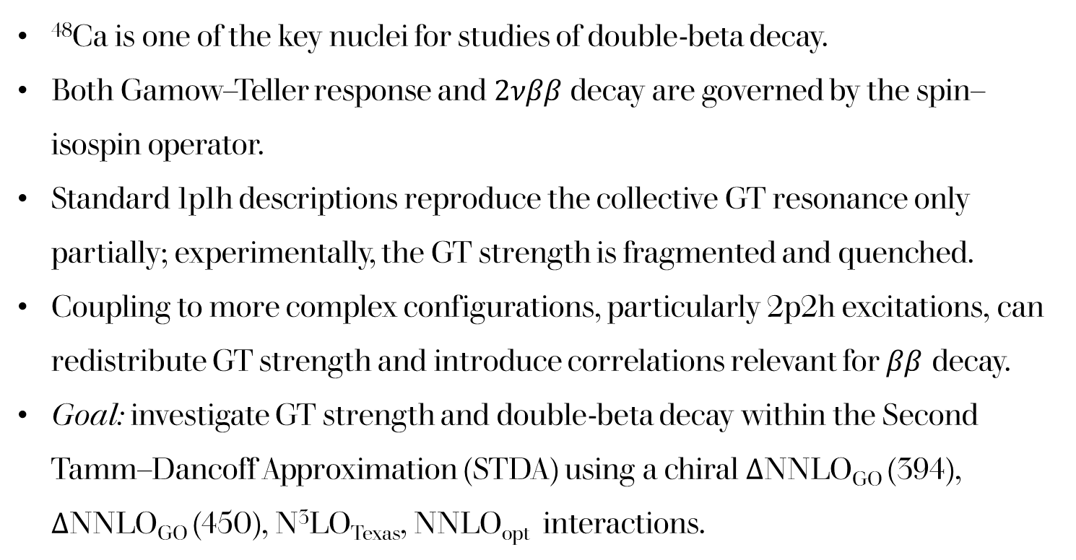
Motivation
⁴⁸Ca is one of the key nuclei for studies of double-beta decay.
Both Gamow–Teller response and $2νββ$ decay are governed by the spin–isospin operator.
Standard 1p1h descriptions reproduce the collective GT resonance only partially; experimentally, the GT strength is fragmented and quenched.
Coupling to more complex configurations, particularly 2p2h excitations, can redistribute GT strength and introduce correlations relevant for $ββ$ decay.
Goal: investigate GT strength and double-beta decay within the Second Tamm–Dancoff Approximation (STDA) using a chiral ΔNNLO_{GO} (394), ΔNNLO_{GO} (450), N³LO_{Texas}, NNLO_{opt} interactions.

Slide 3
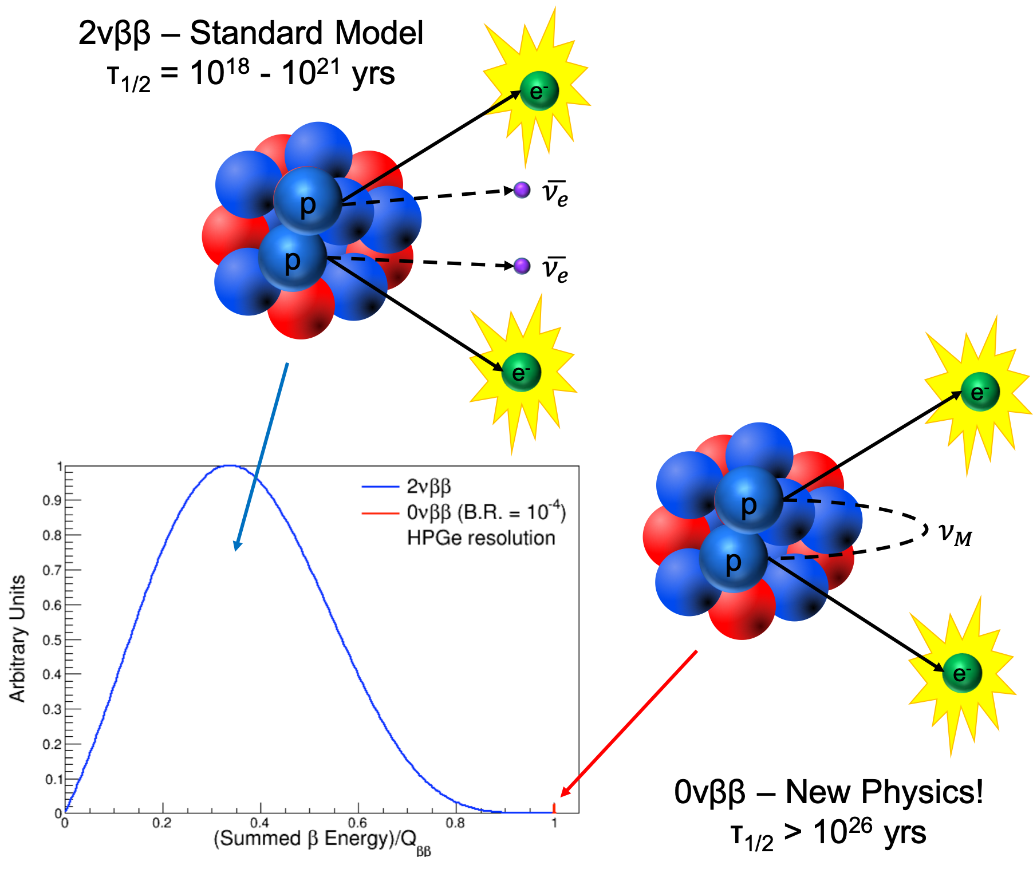
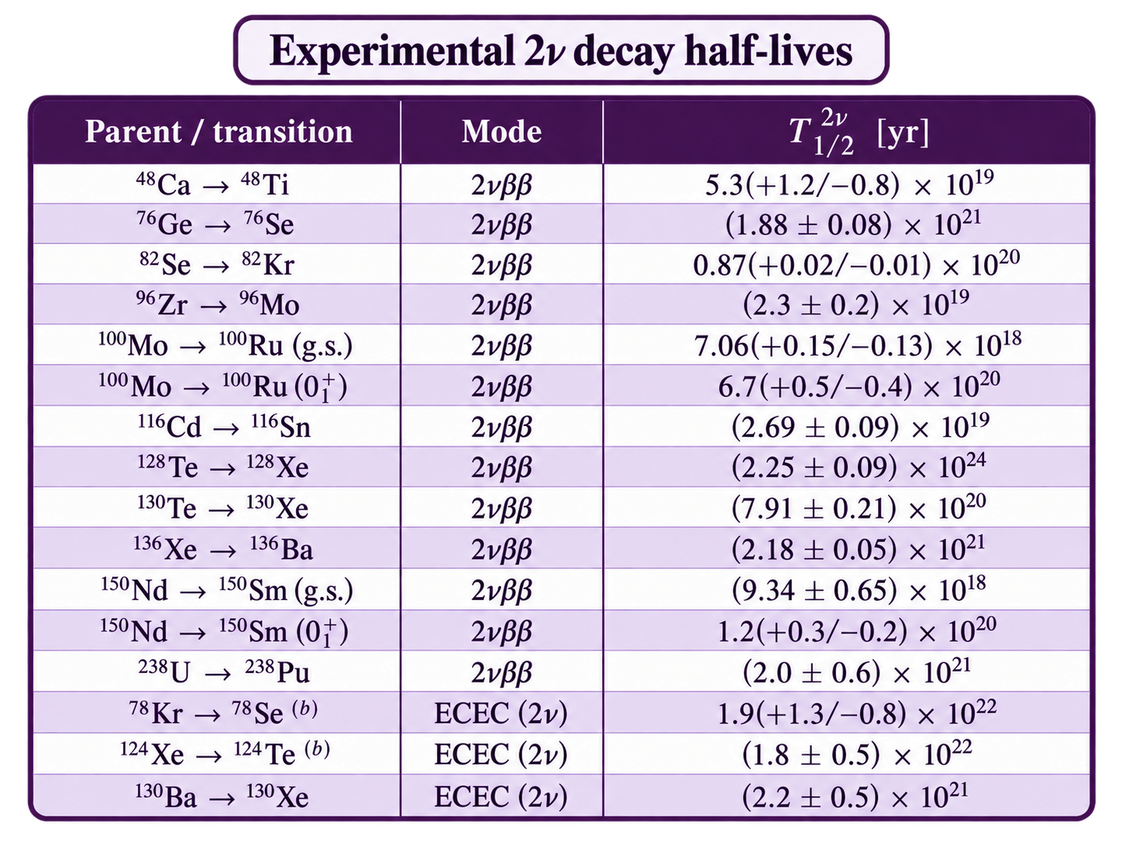

Theoretical background
$${\left(T_{1/2}^{2ν}\right)}^{−1}=G^{2ν}g_{A}^{4}m_{e}^{2}{\left|M_{GT}−\frac{M_{F}}{g_{A}^{2}}\right|}^{2}$$

Slide 4
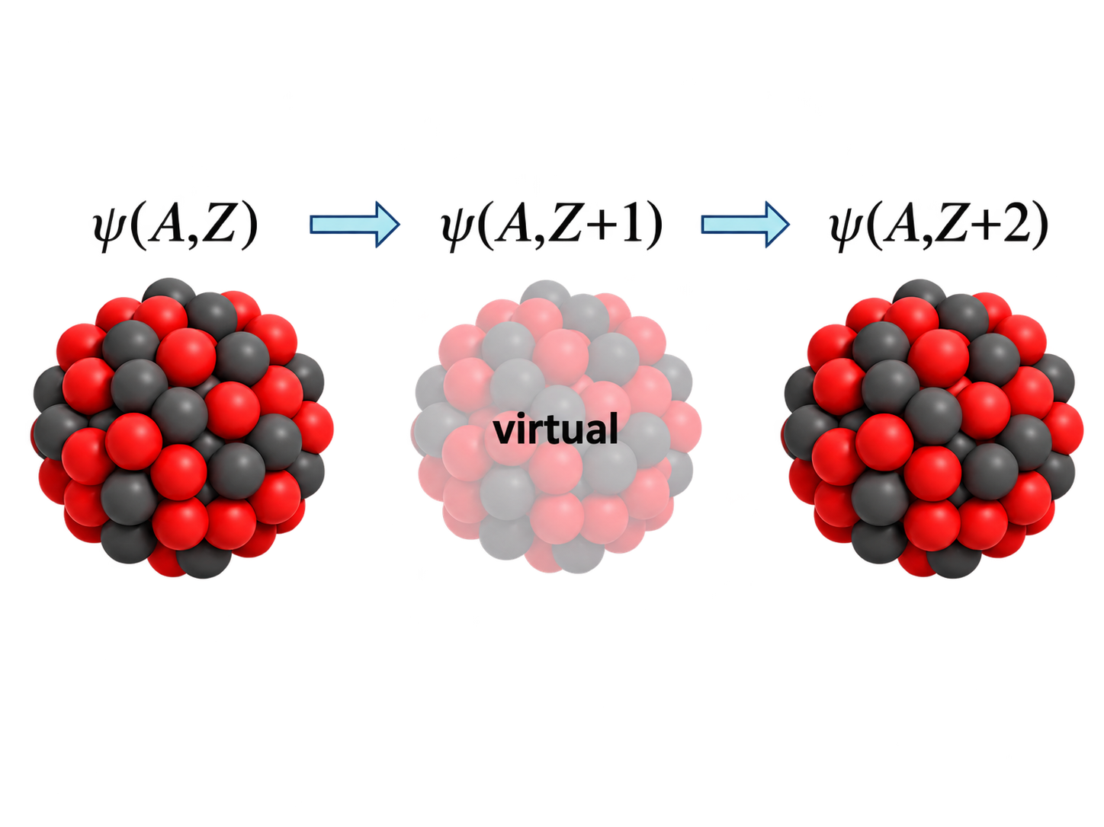
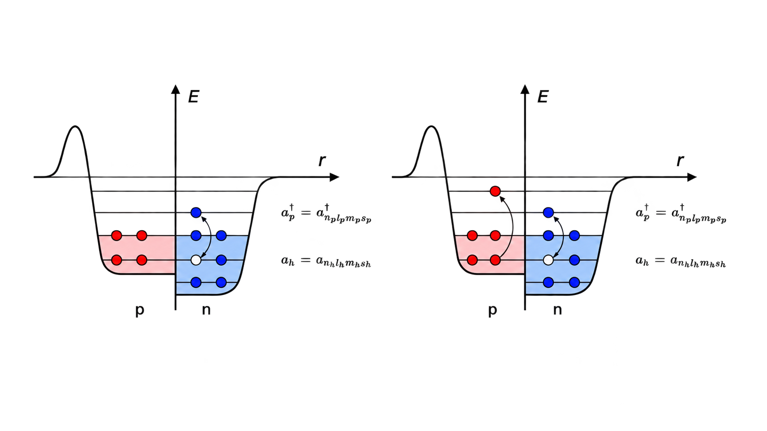

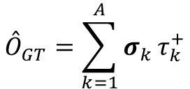
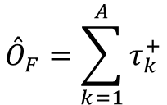
Nuclear matrix element
$$​^{48}Ca\left(0_{i}^{+}\right)→​^{48}Sc\left(1_{m}^{+}\right)→​^{48}Ti\left(0_{f}^{+}\right)$$
$$M_{F,GT}^{2ν}=\sum_{n}{\frac{\left\langle f\left\|{\overset{ˆ}{O}}_{F,GT}\right\|J_{n}^{+}\right\rangle \left\langle J_{n}^{+}\left\|{\overset{ˆ}{O}}_{F,GT}\right\|i\right\rangle }{E_{n}−\left(E_{i}+E_{f}\right)/2}}$$
Fermi operator
$${\overset{ˆ}{O}}_{F}=\sum_{k=1}^{A}{τ_{k}^{+}}$$
1p-1h excitations
2p-2h excitations
Gamow–Teller operator
$${\overset{ˆ}{O}}_{GT}=\sum_{k=1}^{A}{σ_{k}}τ_{k}^{+}$$

Slide 5

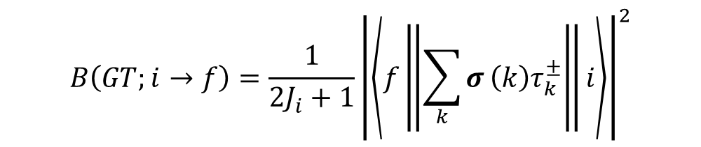



The GT${}_{​}^{−}​$ transition strength
$$B\left(GT;i→f\right)=\frac{1}{2J_{i}+1}{\left|\left\langle f\left\|\sum_{k}{σ}\left(k\right)τ_{k}^{±}\right\|i\right\rangle \right|}^{2}$$
Strength function
$$S\left(E\right)=\sum_{λ}{{\left|\left\langle Ψ_{λ}||{\overset{ˆ}{O}}_{GT}||Ψ_{i}\right\rangle \right|}^{2}}ζ_{Δ}\left(E−E_{λ}\right)$$
Lorentzian curve of width $Δ$
$$ζ_{Δ}=\frac{1}{2π}\frac{Δ}{{\left(E−E_{λ}\right)}^{2}+{\left(Δ/2\right)}^{2}}$$

Slide 6
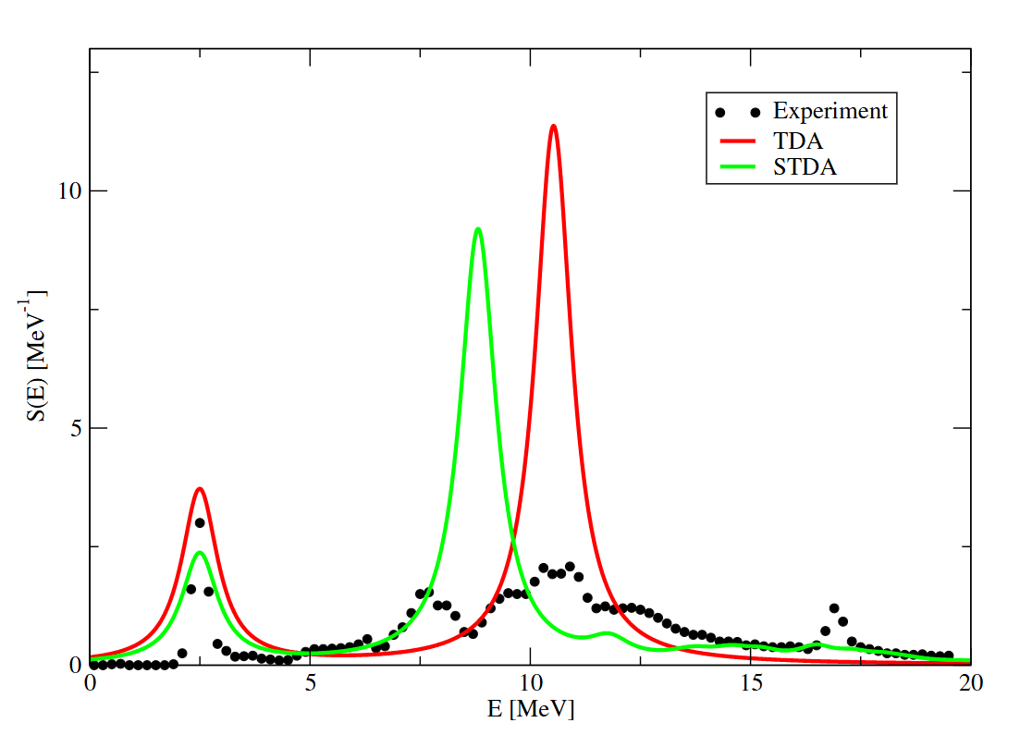
Results
TDA, and STDA, strength functions of GT⁻ transitions from ⁴⁸Ca to ⁴⁸Sc compared to the experimental points extracted from the measurement of ⁴⁸Ca(p,n)⁴⁸Sc.
ΔNNLO_{GO} (394) interaction was used.
Experimental data from: K. Yako, et al., Phys. Rev. Lett. 103, (2009) 012503

Slide 7
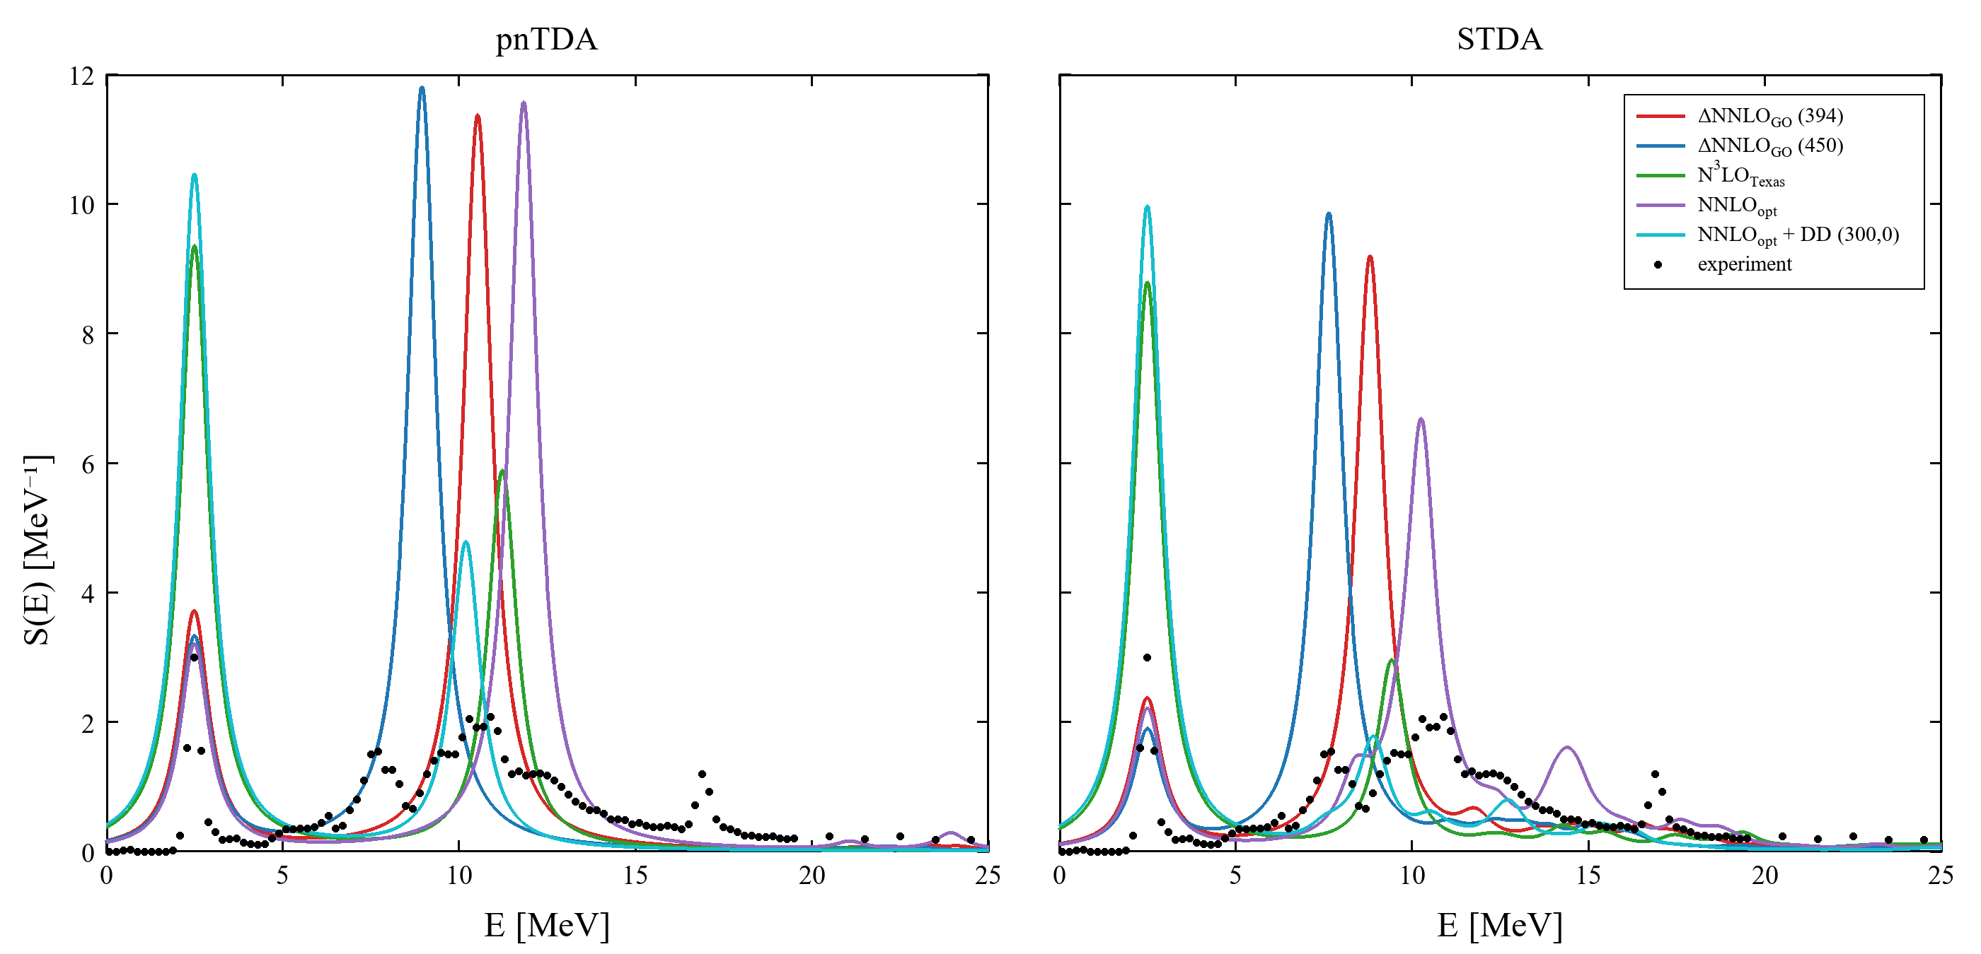

Slide 8
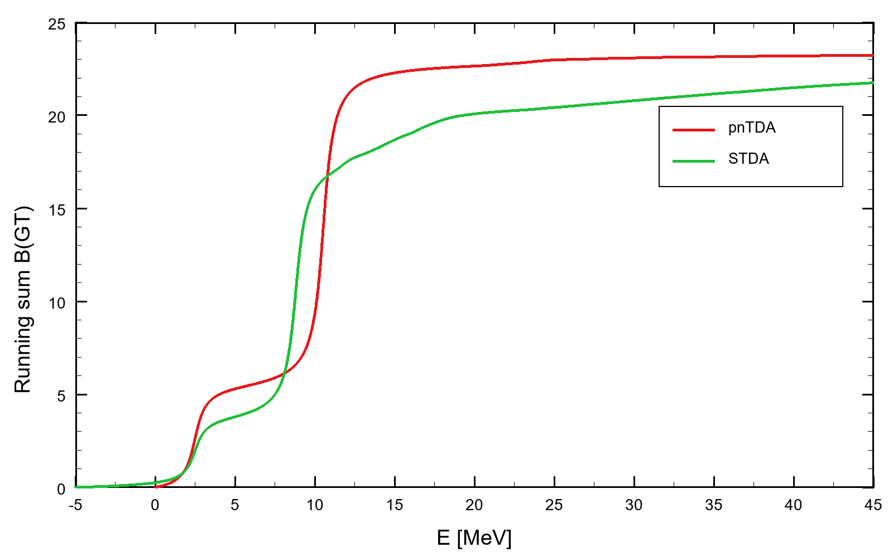

Ikeda Sum Rule
$$Σ_{Ikeda}(^{48}Ca)=3\left(N−Z\right)=24.$$
ΔNNLO_{GO} (394) interaction was used.

Slide 9
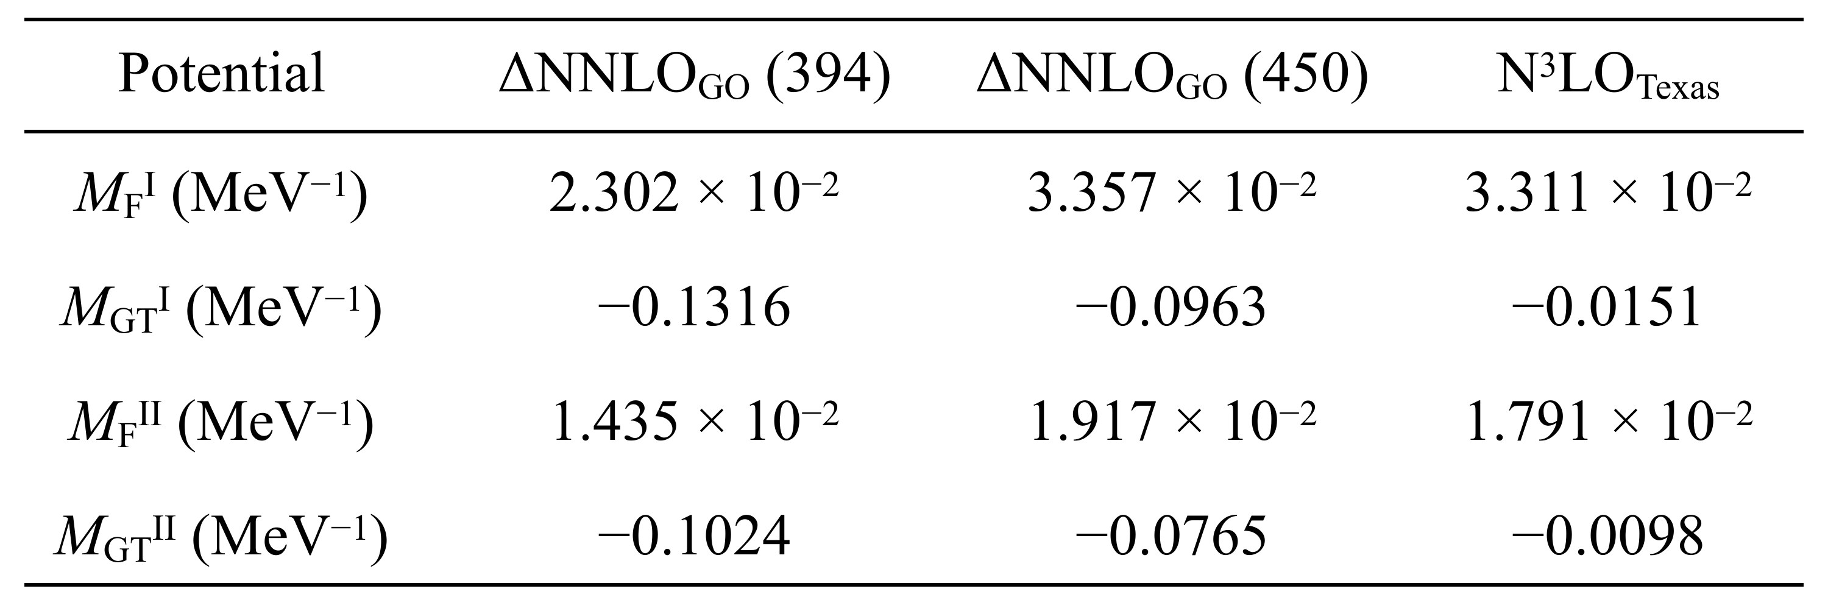
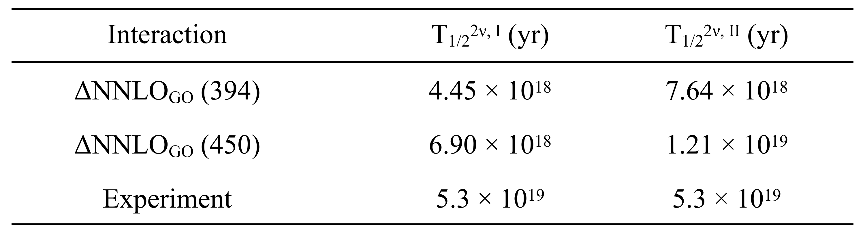
The dependence of Fermi $M_{F}^{I}$, $M_{F}^{II}$, and Gamow-Teller $M_{GT}^{I}, M_{GT}^{II}$, NMEs of $2νββ$-decay depending on the applied potentials $ΔNNLO_{GO}$ (394), $ΔNNLO_{GO}$(450), and $N^{3}LO_{Texas}.$

Slide 10
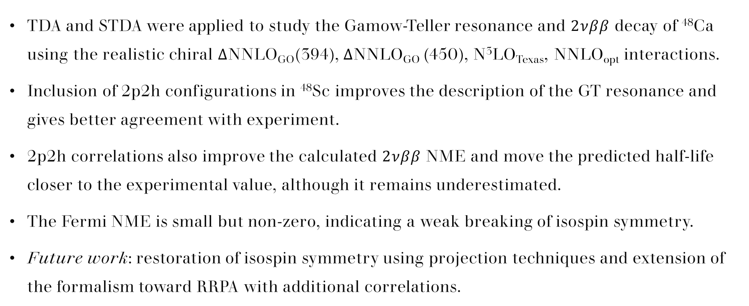
Conclusions
TDA and STDA were applied to study the Gamow-Teller resonance and $2νββ$ decay of ⁴⁸Ca using the realistic chiral ΔNNLO_{GO}​(394), ΔNNLO_{GO} (450), N³LO_{Texas}, NNLO_{opt} interactions.
Inclusion of 2p2h configurations in ⁴⁸Sc improves the description of the GT resonance and gives better agreement with experiment.
2p2h correlations also improve the calculated $2νββ$ NME and move the predicted half-life closer to the experimental value, although it remains underestimated.
The Fermi NME is small but non-zero, indicating a weak breaking of isospin symmetry.
Future work: restoration of isospin symmetry using projection techniques and extension of the formalism toward RRPA with additional correlations.

Slide 11
THANK YOU

