Slide 1
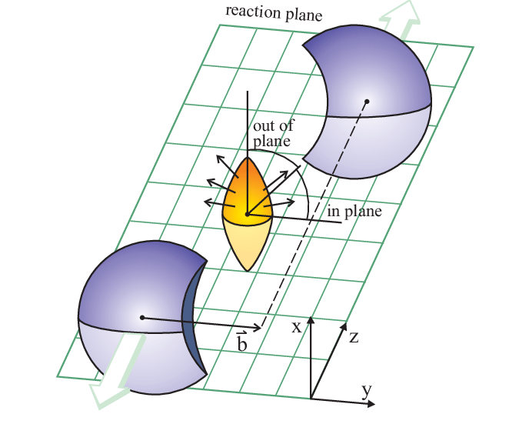
Monte Carlo Analysis of Spectator Nucleons Produced in Ultrarelativistic Xe+La Collisions
Author: Igor Ciarciński
Co-authors:
Paweł Strepikowski
Katarzyna Mazurek
Małgorzata Janik

Slide 2
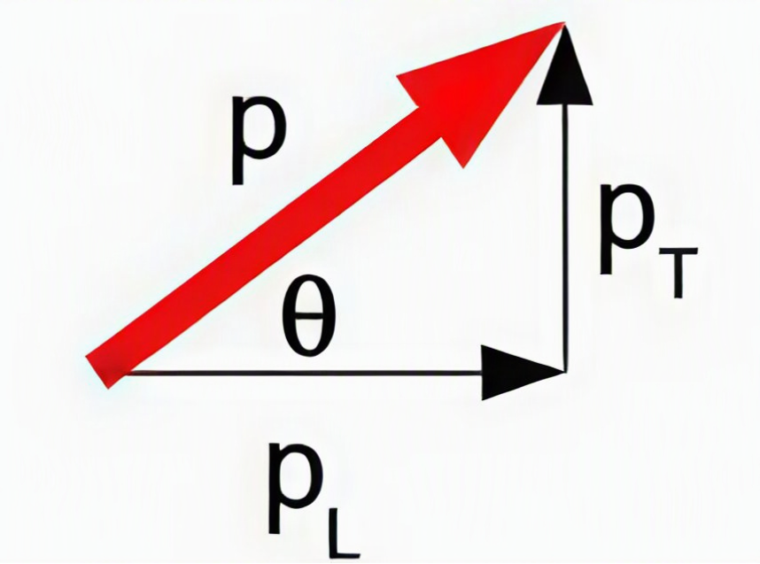
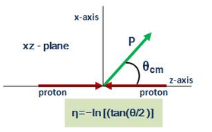
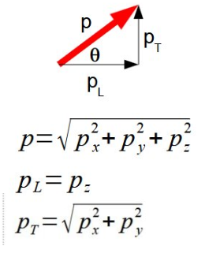
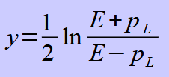
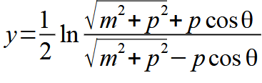
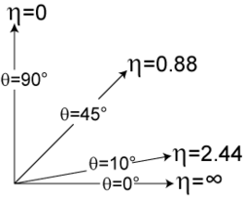
How to describe spectators behavior
Transverse momentum p_{T}
Pseudorapidity
Rapidity
Or, using polar angle:

Slide 3
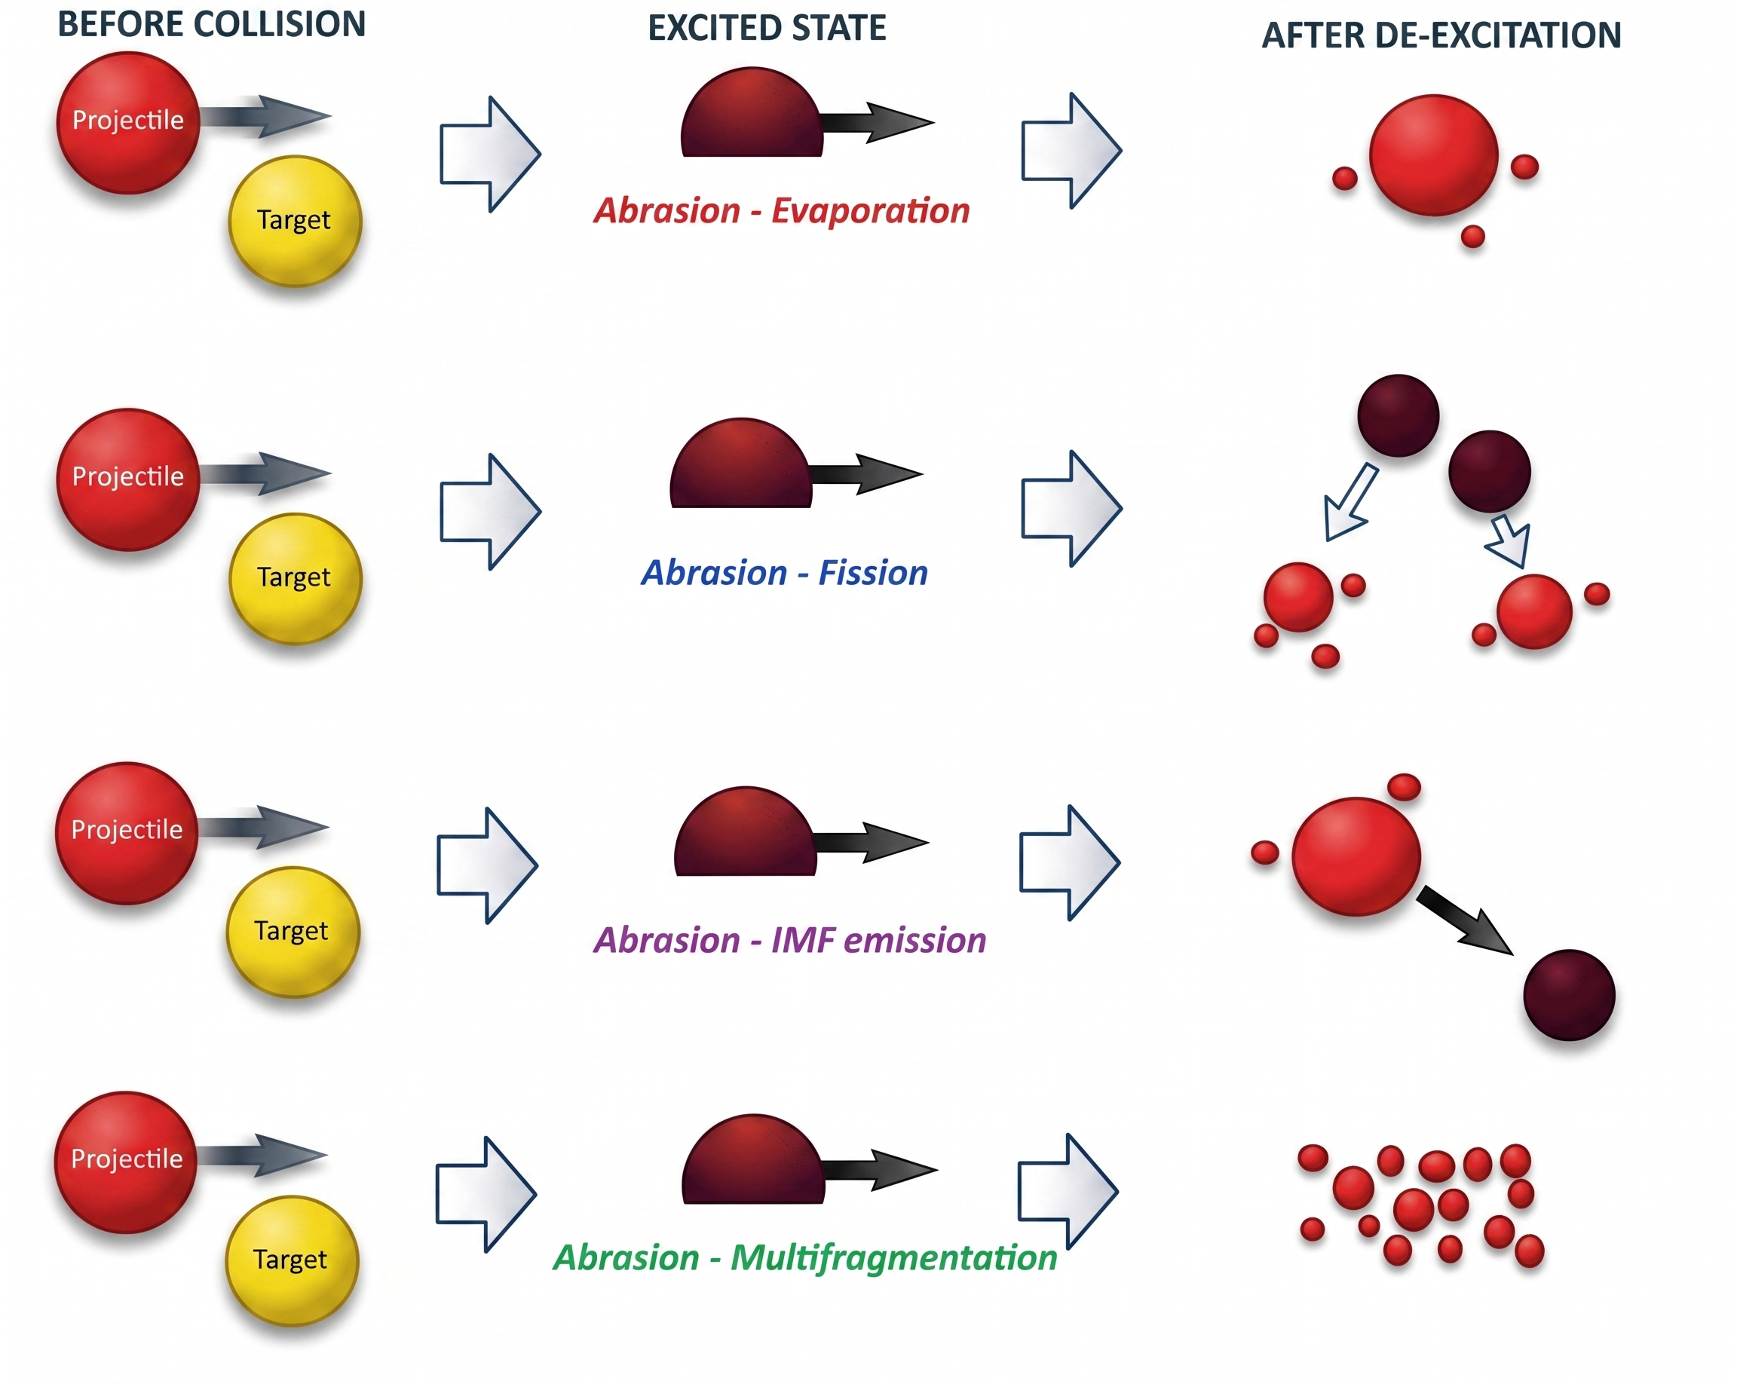
Spectators de-excitation process
4 main mechanism of de-excitation:
  Evaporation
  Fission
  Intermediate mass emission
  Multifragmentation

Slide 4
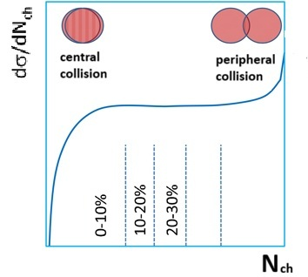
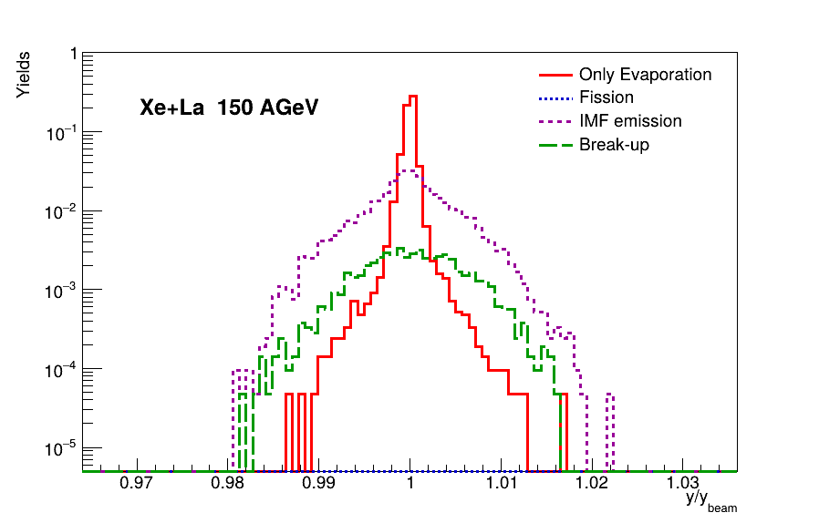
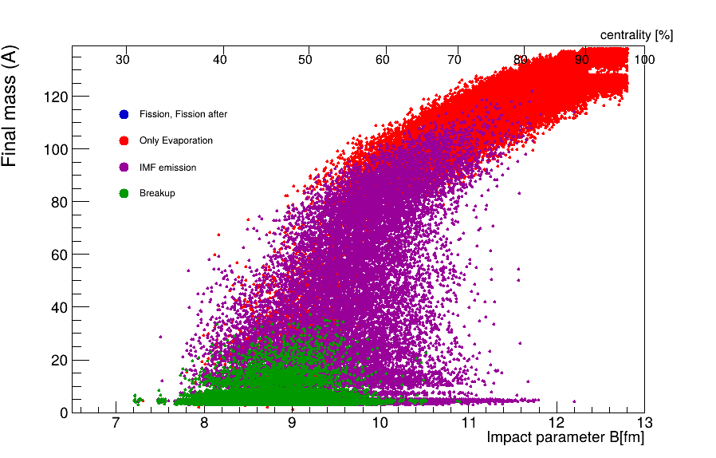
Different channels of de-excitation
Data generated with ABRABLA
Reduced rapidity distribution of spectators
-small spread around beam rapidity
-Mainly evaporation
Final mass as a function of impact parameter

Slide 5
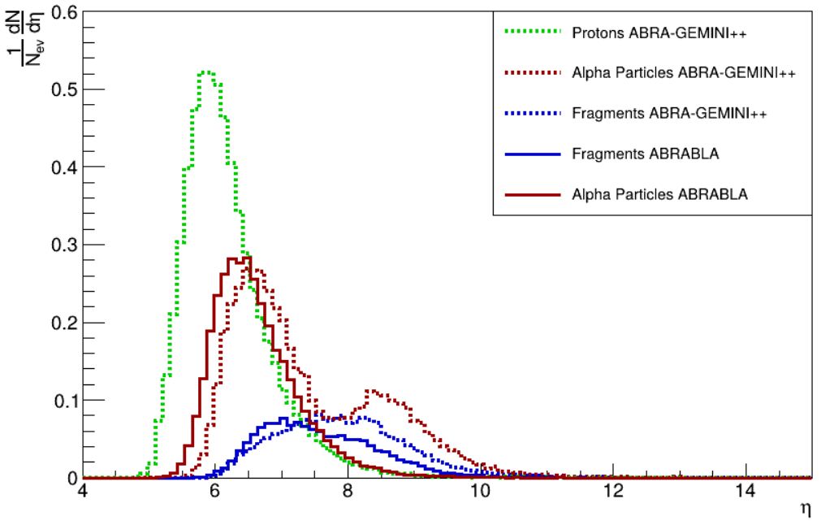
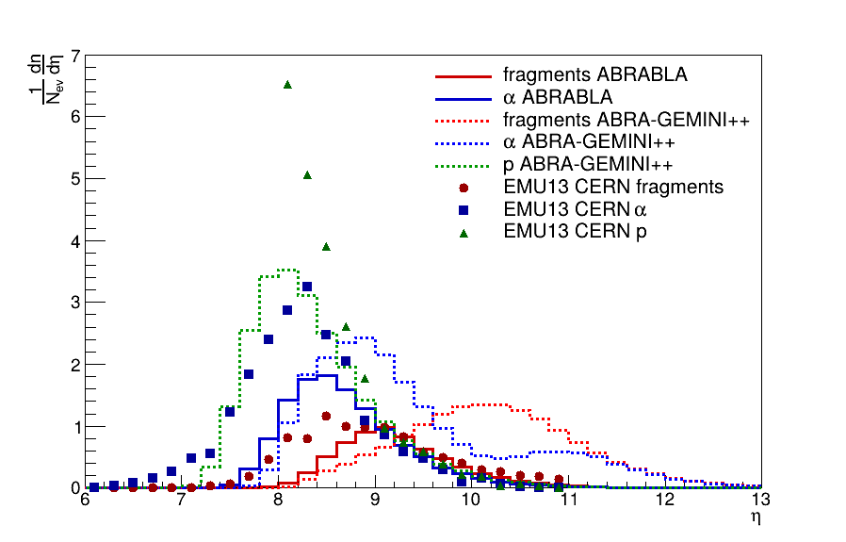
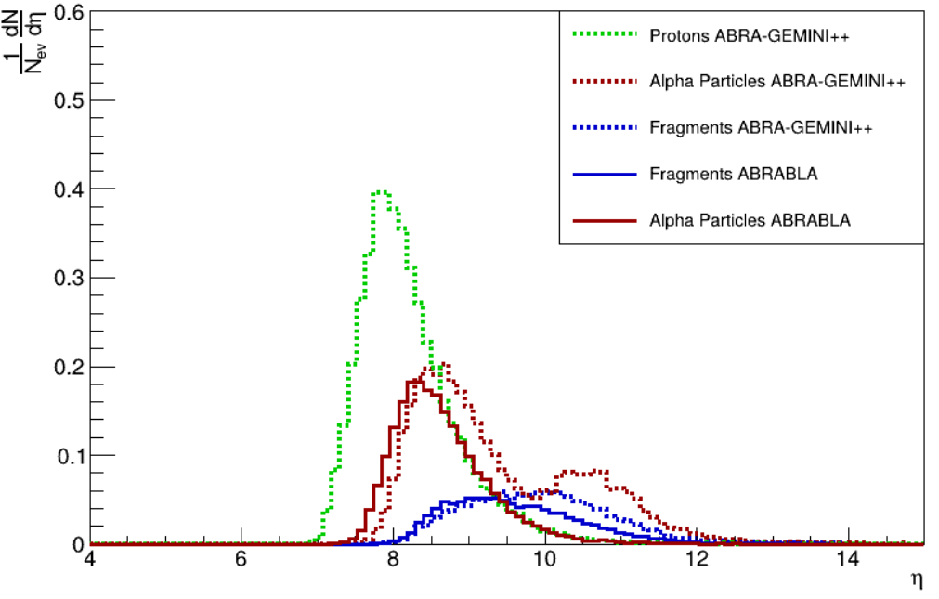
Pseudorapidity distributions
20AGeV
Xe + La
Pb-Pb 158AGeV
150AGeV
PM. L. Cherry et al. (KLM Collab.), Acta Phys. Pol. B29, 2155 (1998)

Slide 6
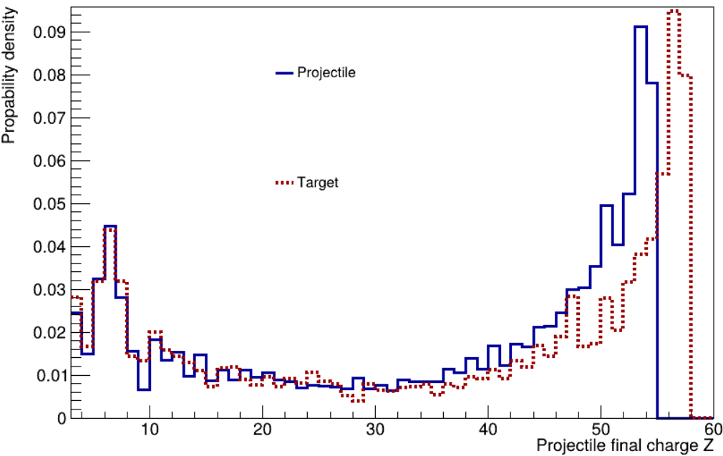
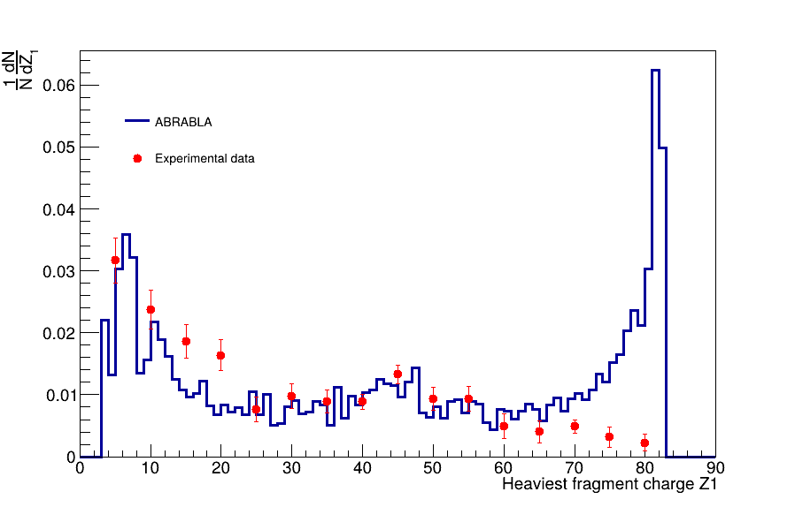
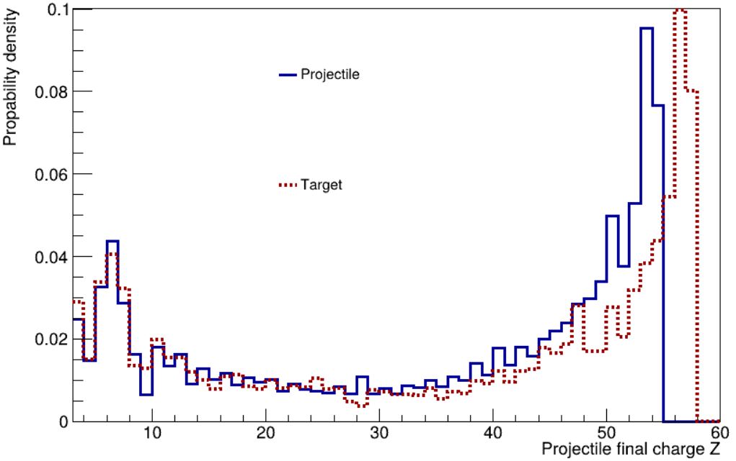
Charge distributions
Xe
20AGeV
La
Pb-Pb 158AGeV
PM. L. Cherry et al. (KLM Collab.), Acta Phys.
Pol. B29, 2155 (1998)
Emission from projectile (Xe) and target (La)
Xe
150AGeV
La
Heaviest fragment charge distribution

Slide 7
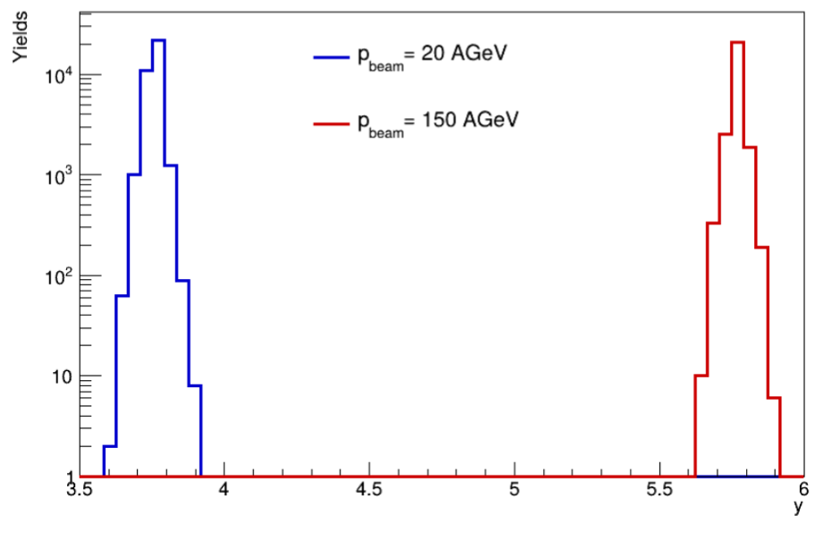
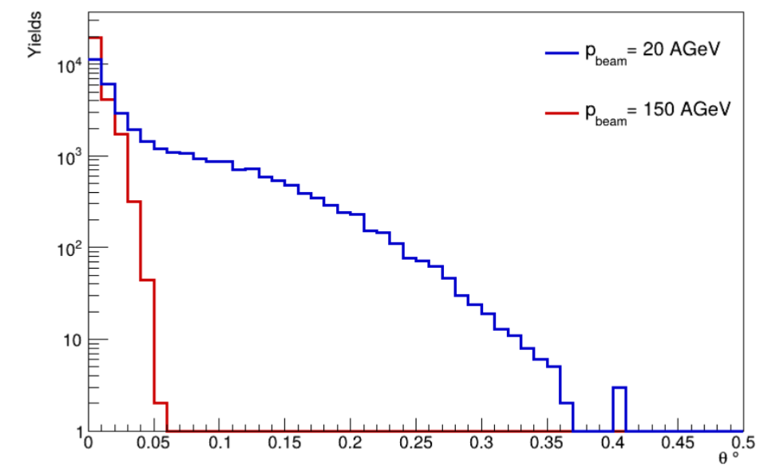
Rapidity and angular distributions for Xe + La
-Rapidity is distributed around 3.75 for 20AGeV energy
-For 150AGeV, it shifts to higher value of around 5.8
-For higher energies particles are produced closer to beam direction
-Even for lower energy the polar angle is less than half a degree

Slide 8
Summary
ABRABLA reproduced experimental data for ultrarelativistic, peripheral collisions
Can be used to predict results for other experiments (new systems, different energies...) in high energy physics experiments
Prepared distributions of various kinematics quantities like rapidity etc, for different energies with Xe+La system

