Slide 1
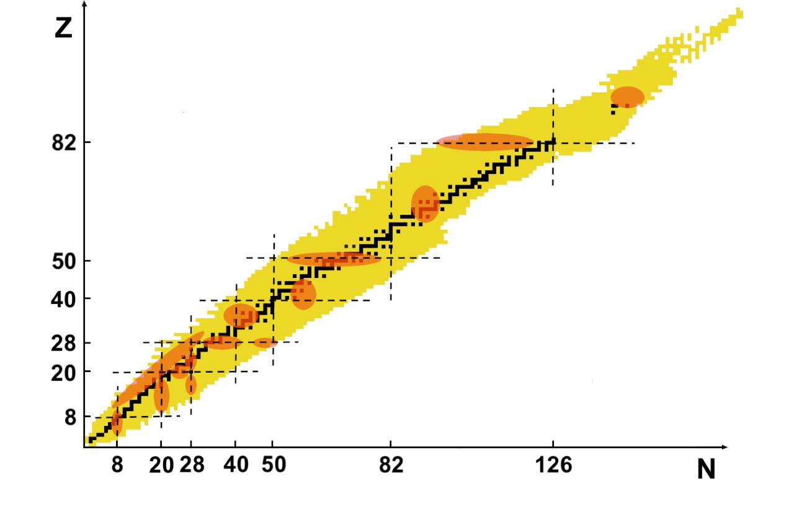
Nuclear Structure of the Zr isotopes: Collectivity, Phase Transitions, and Shape Coexistence
Paul Garrett
University of Guelph

Slide 2
QPTs in the structure of nuclei
a
Common Hilbert space – changes in symmetry of system, may be a 1st or 2nd order transition
Crossing of configurations – if weak mixing, abrupt change in ground state properties → 1st order phase transition
Garcia-Ramos, SSNET2018

Slide 3
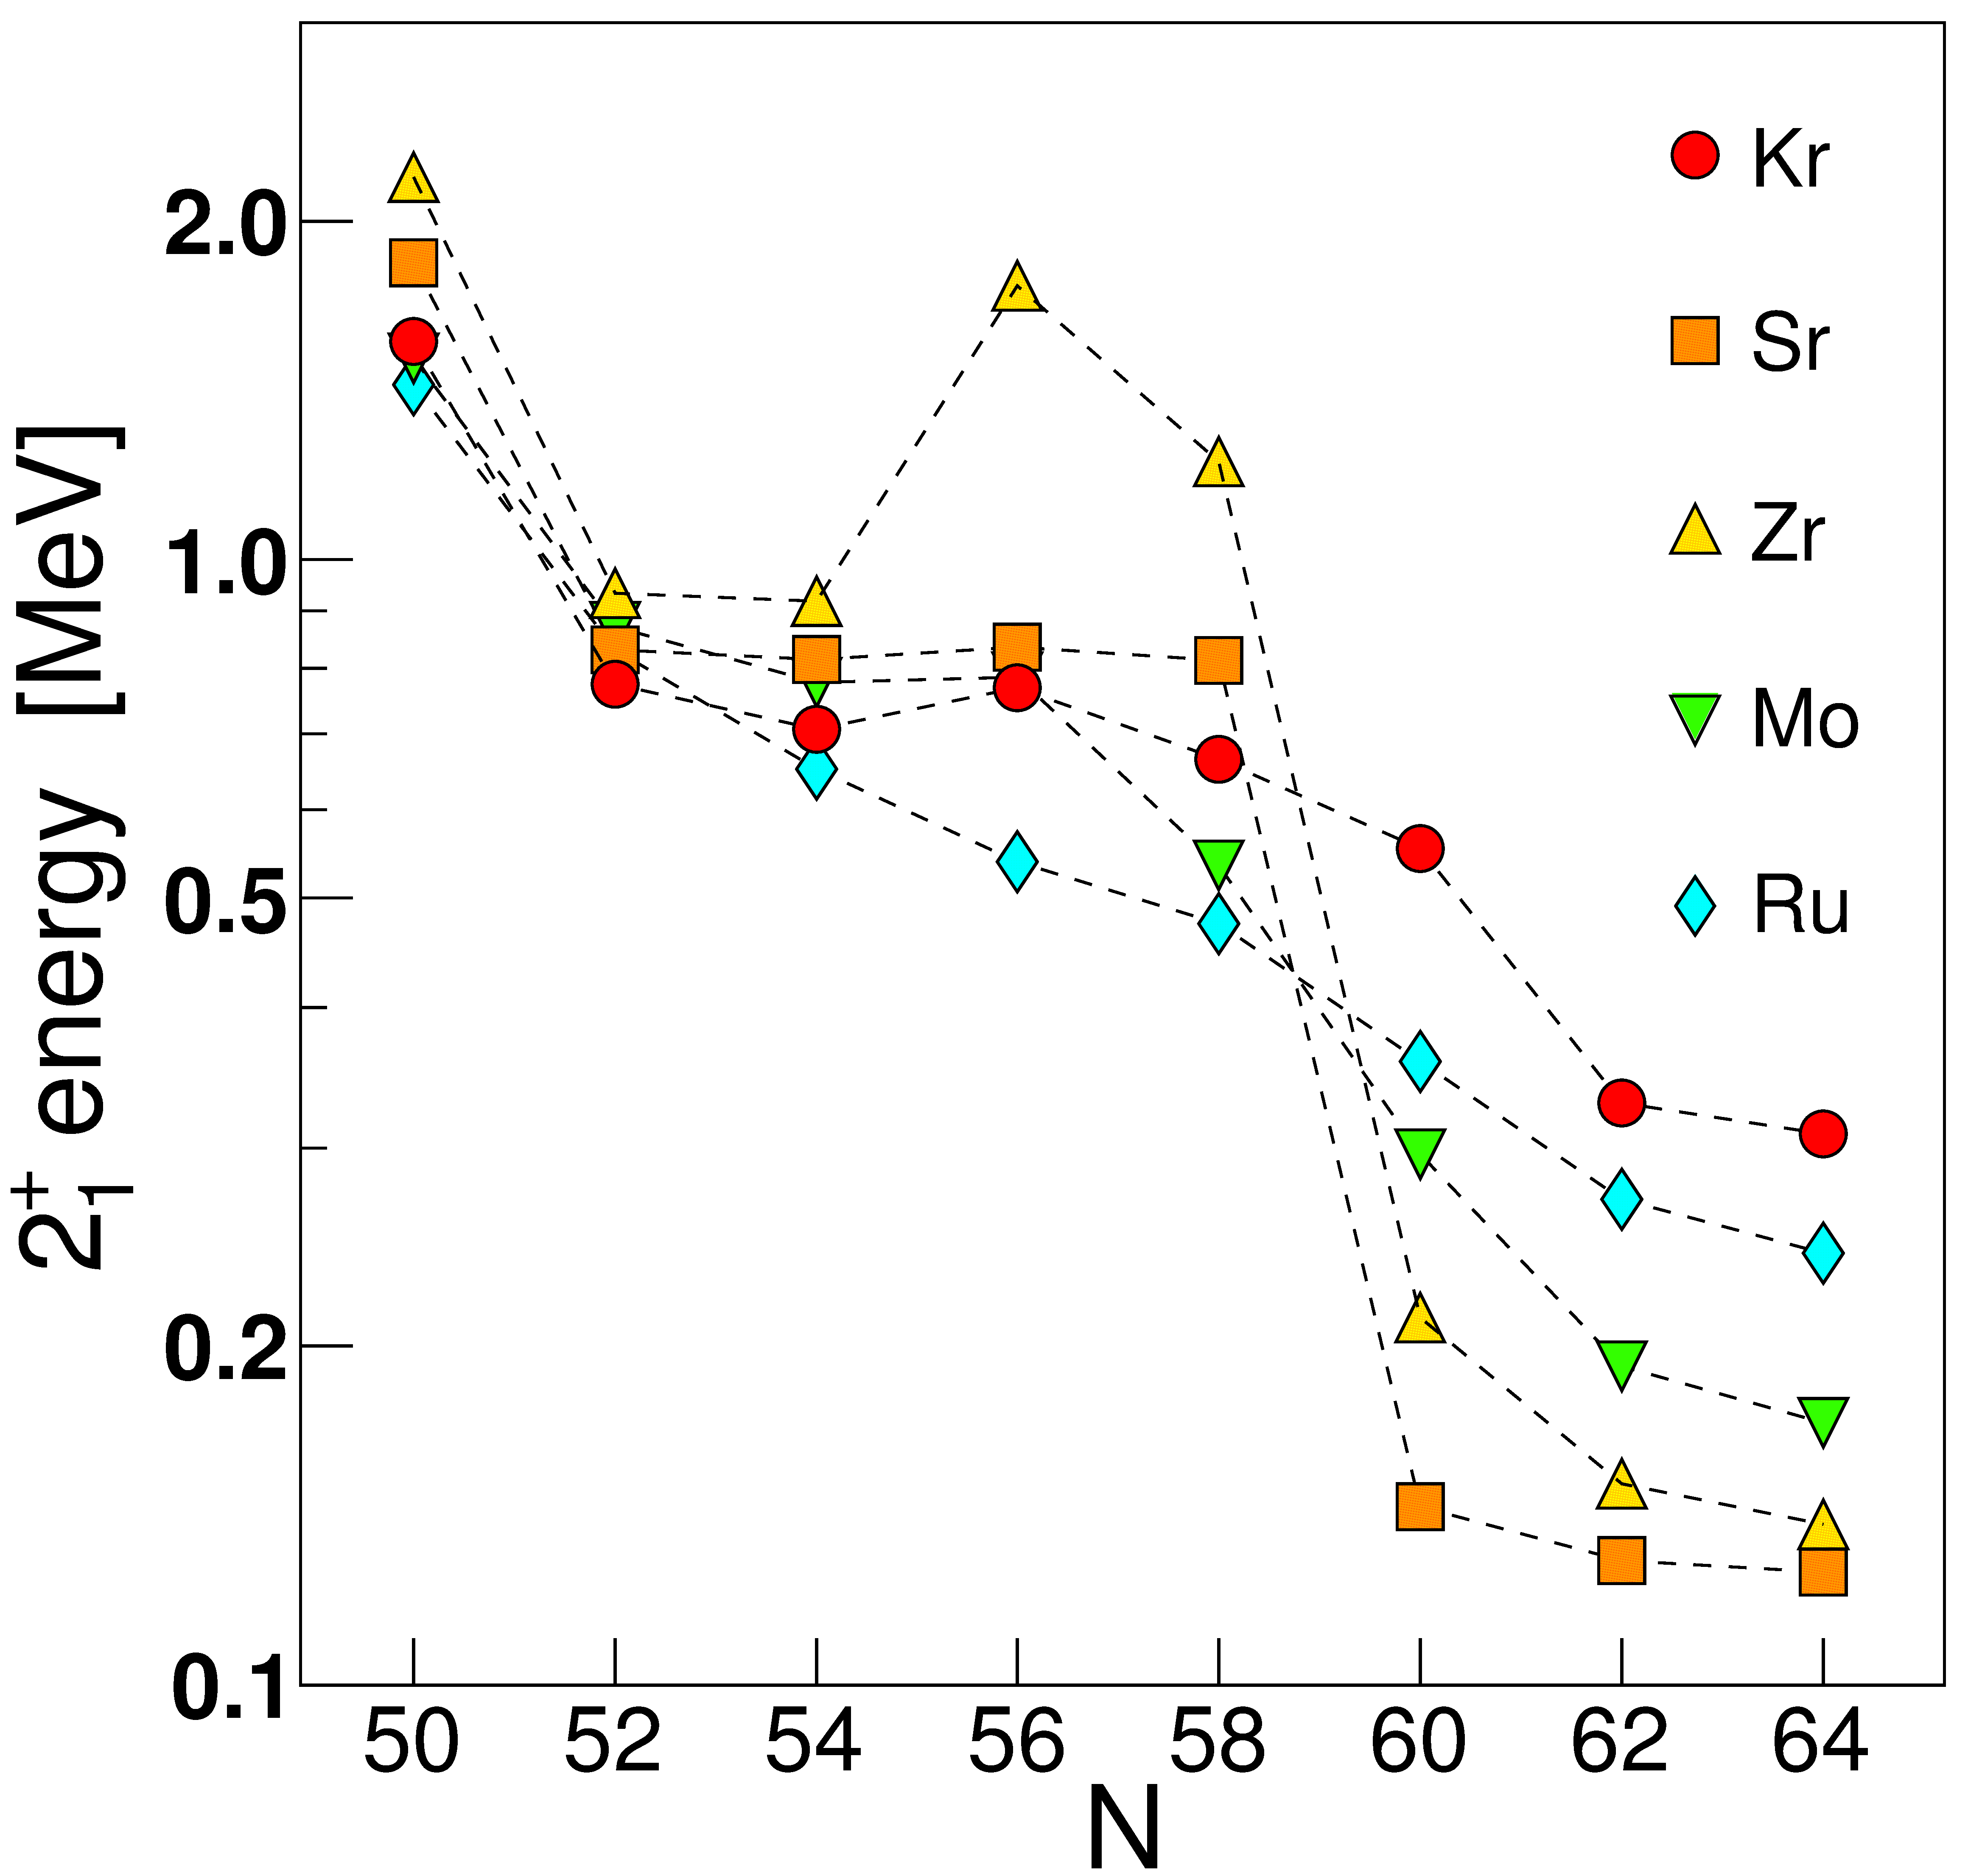
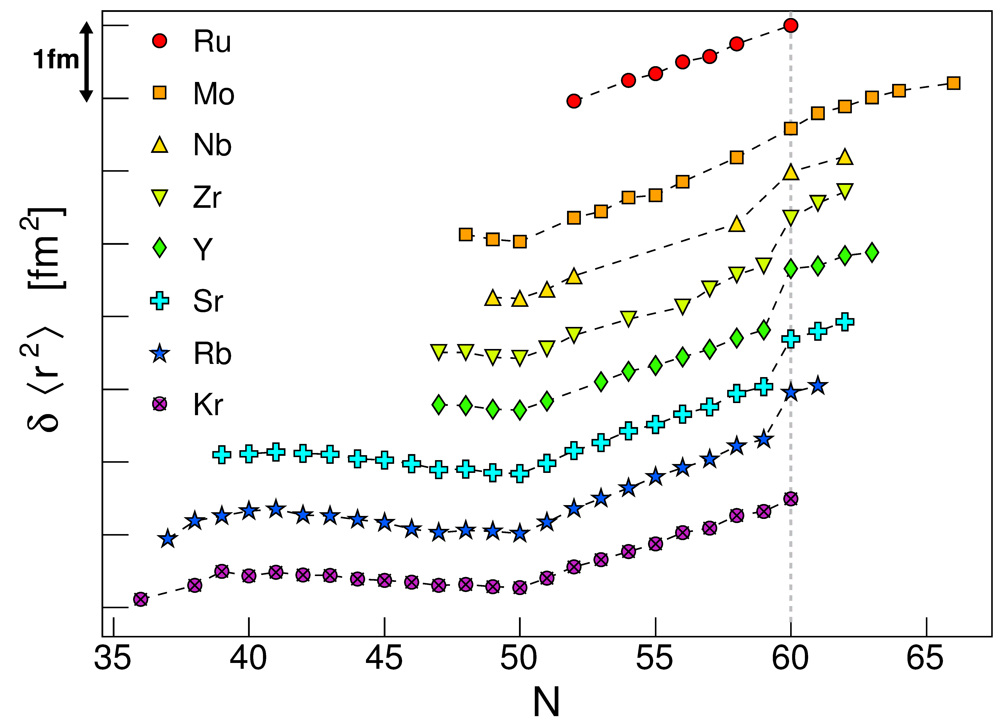
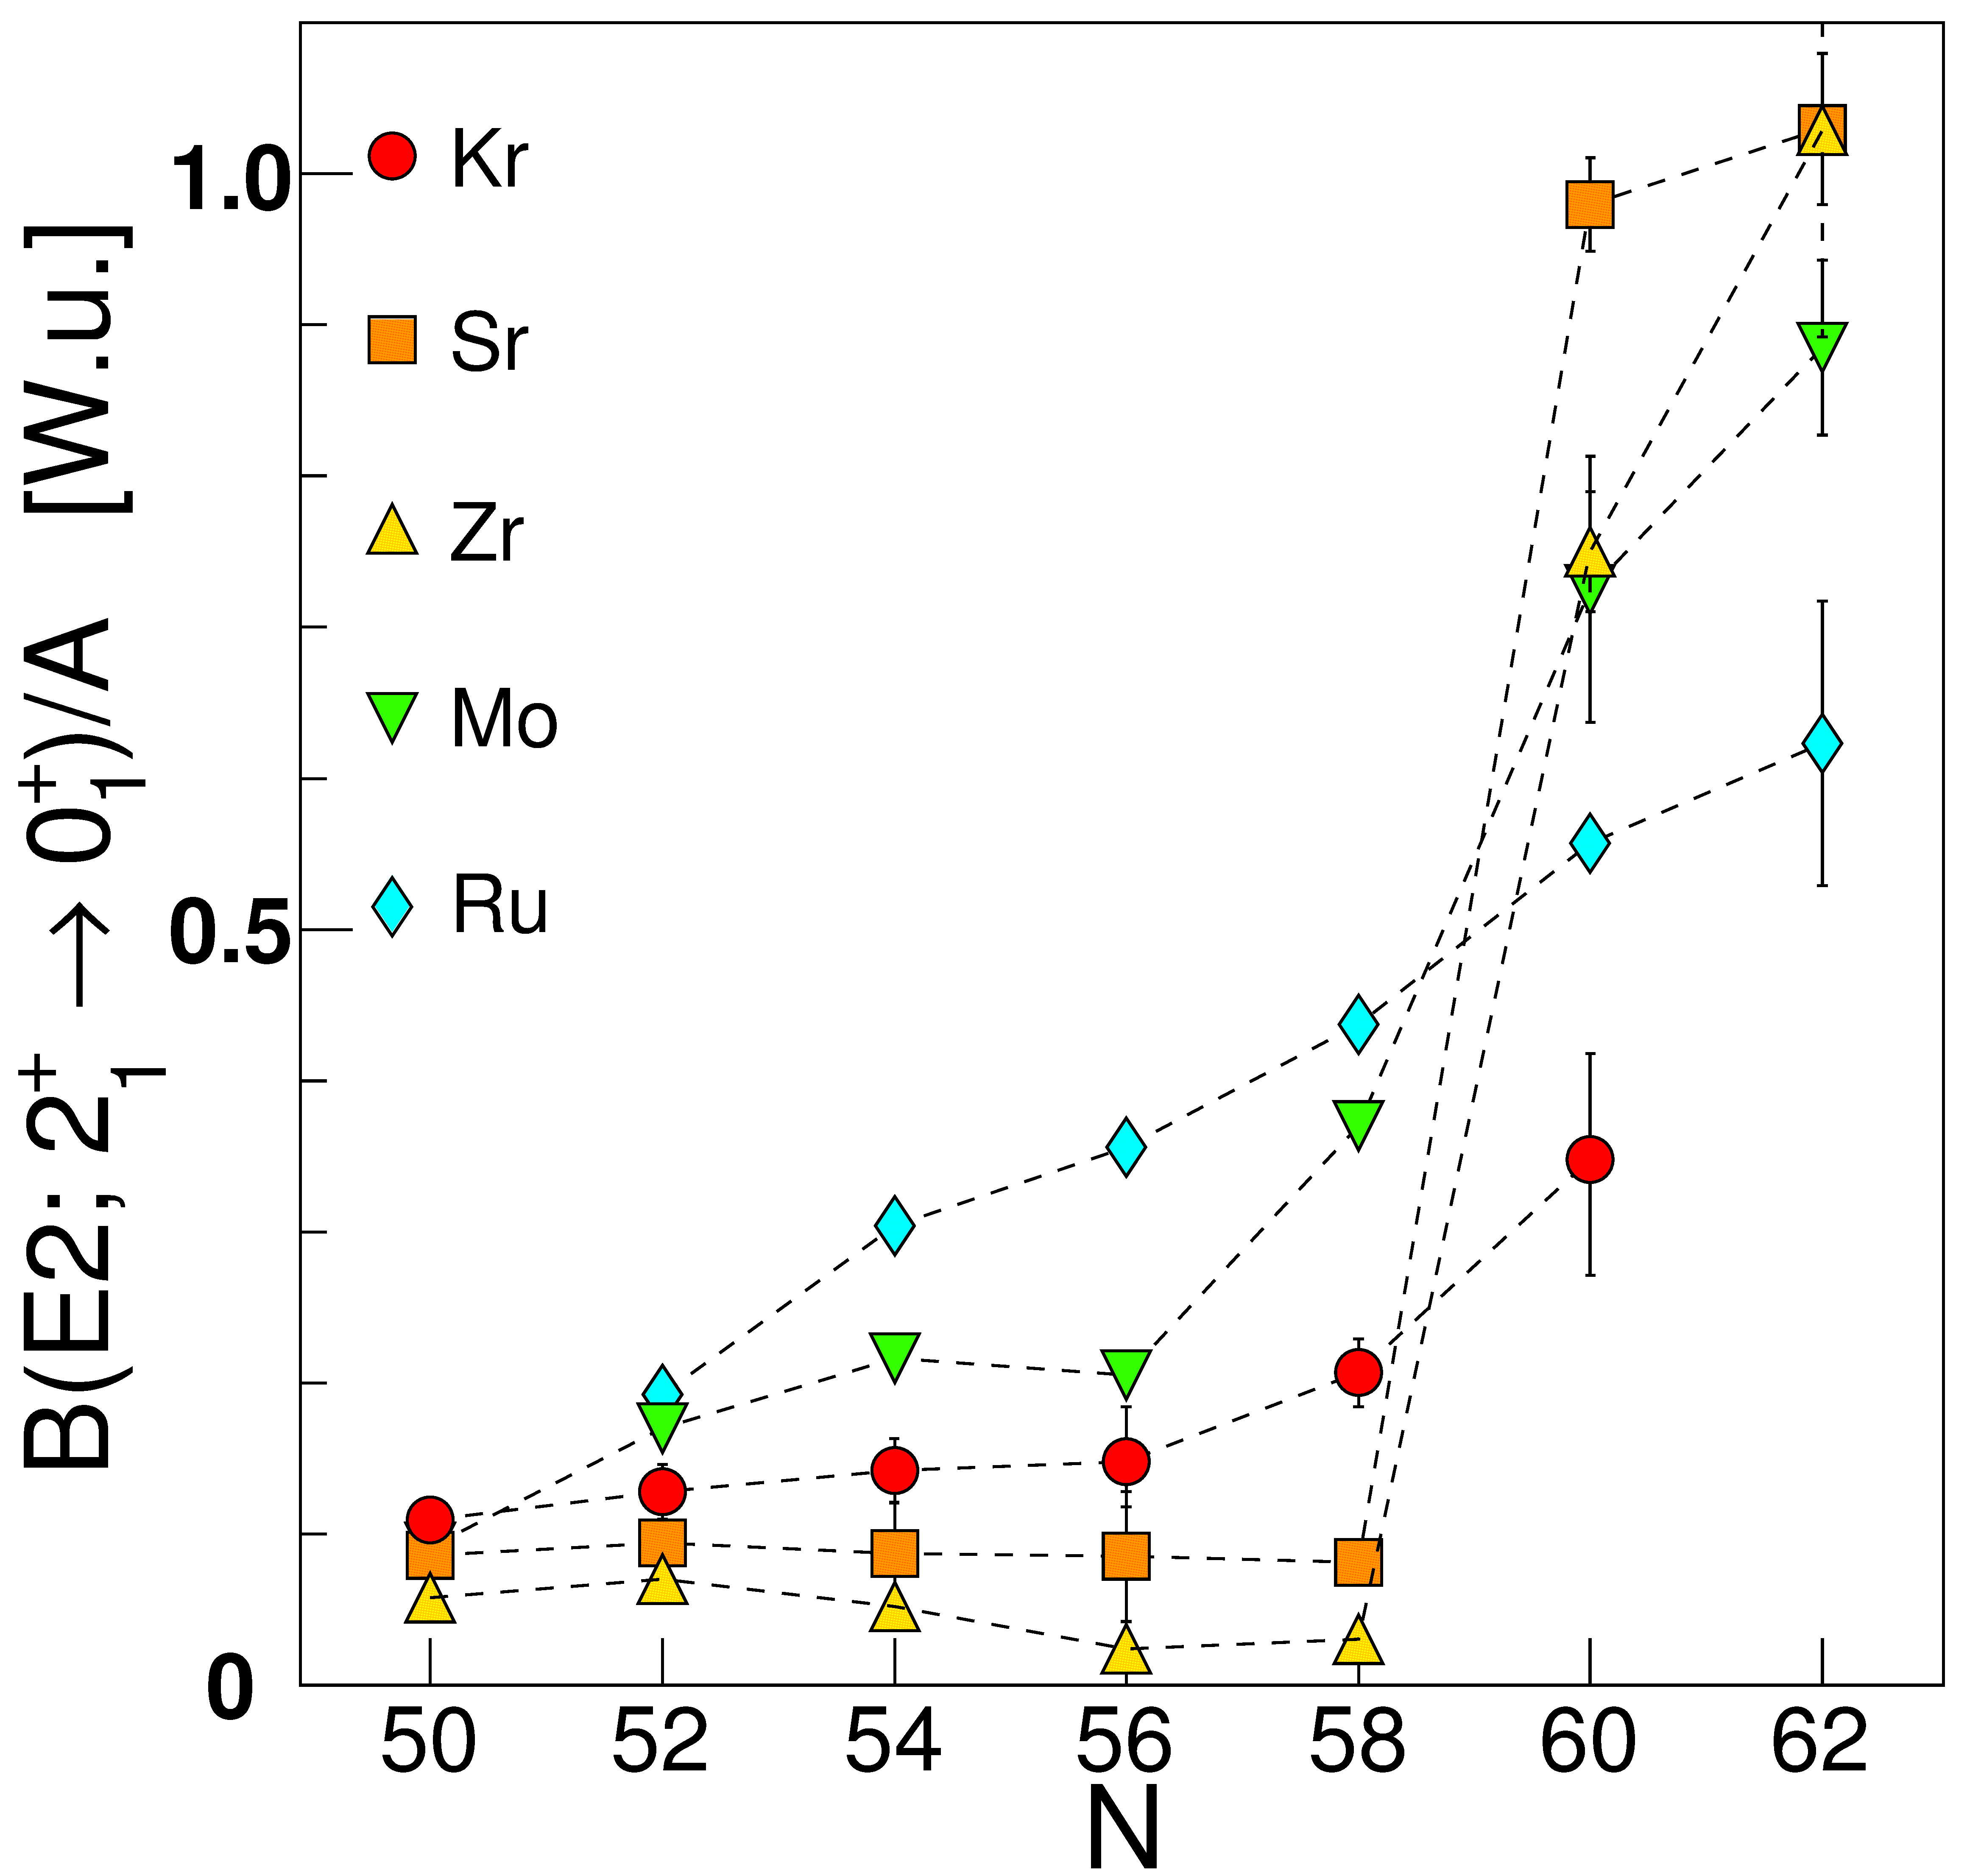
Dramatic change in ground state shape at N=60 for Rb – Nb isotopes – evidence for a 1st order QPT
Mean square charge radii show sudden and pronounced jump at N=60
Rapid decrease in E(2₁⁺), increase in B(E2;2₁⁺→0₁⁺)
Garrett, Zielińska, & Clément, PPNP 124, 103931 (2022)
Measured isotope shifts

Slide 4


Shape coexistence near Z = 40: ⁹⁶⁻¹⁰²Mo show clear evidence, and anchor the region
Detailed Coulomb-excitation studies enable extraction of shape invariants indicating clearly different shapes for 0₁⁺ and 0₂⁺ states
Strong E0 transitions indicate differences in deformation and mixing of configurations
prolate
triaxial
$$\left\langle Q^{2}\right\rangle ∝\left\langle β^{2}\right\rangle$$
$$\cos{3δ}≈\cos{3γ}$$
oblate
M. Zielińska et al., NPA 712, 3 (2002), K. Wrzosek-Lipska et al., PRC 86 064305 (2012)
B(E2) (Wu)
10³ρ²(E0)

Slide 5
Recent theoretical calculations for Zr isotopes
MCSM
p-n tensor interaction reduces Z=40 gap as νg_{7/2} shell is filled
Lower gap enables additional proton excitations, creating a self-reinforcing mechanism – type-II shell evolution
IBM-CM
Intertwined quantum phase transition – a QPT in the shape evolution of one configuration, combined with a crossing of the second configuration
N. Gavrielov, A. Leviatan, and F. Iachello, PRC 105, 014305 (2022).
Spherical
Deformed
IBM-CM calculations also by J. E. Garcia Ramos and K. Heyde, PRC 100, 044315 (2019),
PRC 102, 054333 (2020)
T. Togashi et al., PRL 117, 172502 (2016)

Slide 6
Evidence for Evolution of ESPEs in ⁹⁹Zr
Measurement of g-factors for states in ⁹⁹Zr, and reproduced results with IBFM calculation
½⁺ ground state – near vanishing s_{1/2} wave function content
  s_{1/2} state at 385 keV in calculation

Slide 7
Evidence is not so firm
(or, there’s more than one way to skin a cat)
Boulay et al., PRL 124, 112501 (2020)
PG, PRL (Comment) 127, 169201 (2021)
  ⁹⁷Zr ½⁺ gs definitely s_{1/2} neutron state from single-neutron-transfer results (S=1.02)
  Magnetic moment ½⁺ state ⁹⁷Zr −0.937(2)(3) μ_{N}
  Magnetic moment ½⁺ state ⁹⁹Zr −0.930(4) μ_{N}
ESPEs for ⁹¹⁻⁹⁷Zr derived from transfer results McGregor et al., EPJ A53, 50 (2017), combined with neutron SPEs in IBFM calculation using ¹⁰⁰Zr as core
ESPEs from transfer, with IBFM SPEs from Brant et al., PRC 58, 13449 (1998) using boson parameters for ⁹⁶Sr

Slide 8
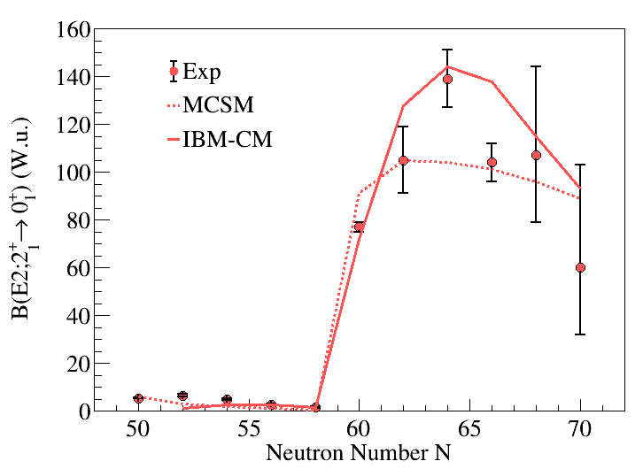
Predictions of Zr B(E2;2₁⁺ → 0₁⁺) compared with experimental values
Both models do well reproducing the sudden transition, and the overall trends in the data
To differentiate, we need data on excited structures – do they behave as rotational bands, or multiphonon states?
MCSM – Togashi et al., PRL 117, 172502 (2016)
IBM-CM – Gavrielov et al., PRC 105, 014305 (2022).

Slide 9
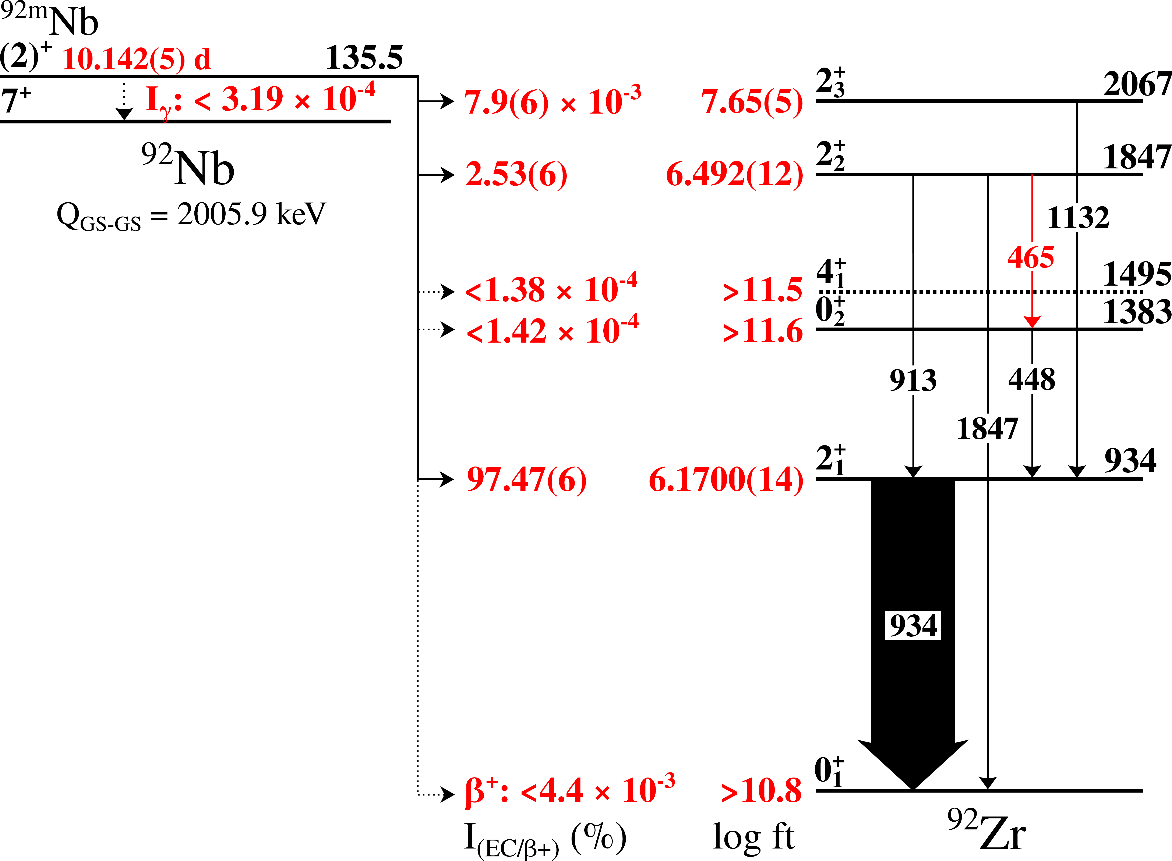
New study of ⁹²Zr via ^{92m}Nb decay
⁹²Zr level structure investigated using ^{92m}Nb, t_{½}=10.1 d, β⁺/EC decay.
Source produced using TRIUMF TR13 medical cyclotron, 13 MeV p on ^{nat}Nb foils, 5 μA for 15 min.
Source activity measured using GRIFFIN for 21 days following 3 days cooling
J. Williams, PG et al., PRC (submitted)

Slide 10
Emergence of collectivity in 0₂⁺ band
Lifetimes of levels in ⁹²Zr known from (n, nʹγ) (E. Peters et al., PRC 88, 024317 (2013))
Comparison of 0₂⁺ bands
⁹²Zr vs. ⁹⁴Zr
Energy spacing:
465 vs. 371 keV
B(E2) values:
8.9(7) vs. 18.8(9) W.u.
g-factors 2₂⁺ states:
+0.76(50) vs. +0.88(27)
Werner et al., PRC 78, 031301(R) (2008)
B(E2) W.u.
10³ρ²(E0)
J. Williams, PG et al., PRC (submitted)

Slide 11
Similar populations in Mo(⁶Li,⁸B) reactions
Two proton pickup conducted on Mo isotopes (⁶Li,⁸B)
  0₂⁺ states in ⁹²Zr, ⁹⁴Zr have very similar cross section ratios, ~20%, relative to gs
Two neutron cross sections few % relative to gs
Suggest that we have the same underlying configuration of 0₂⁺ states in ⁹²Zr and ⁹⁴Zr
R. Tickle et al., NPA 376, 309 (1982)

Slide 12
Dramatic change in transfer population pattern in ⁹⁶Zr
B(E2) W.u.
10³ρ²(E0)
α transfer
2p transfer
2n transfer

Slide 13
“Tension” between recent measurements and interpretations in ⁹⁸Zr
Lifetimes from P. Singh et al. PRL 121, 192501 (2018) generally shorter than those of V. Karayonchev et al. Phys. Rev. C 102, 064314 (2020)
Singh et al. favoured multiple shape coexistence with deformed band structures, Karayonchev et al. favoured a multiphonon-like structure with configuration mixing
B(E2) W.u.
A key transition is the 155-keV 2₂⁺→ 0₃⁺ :
in deformed picture, MCSM predicts 49 W.u.
in IBM-CM picture 3 – 6 W.u.
Using measured lifetime and current branching ratio leads to ~ 500 W.u., recognized as unrealistically large
10³ρ²(E0)
{
}
“2-phonon” states
deformed band
Garrett, Zielińska, & Clément, PPNP 124, 103931 (2022)

Slide 14
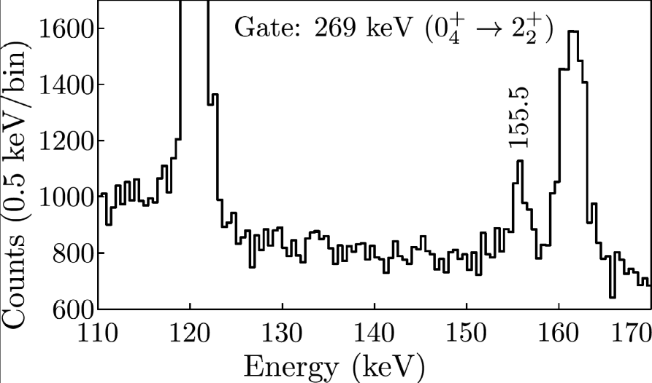
New results on ⁹⁸Zr reveal strongly deformed band
New measurement of branching ratio of 2₂⁺ → 0₃⁺ transition strongly supports assignment of rotational band based on 0₃⁺ state
K. Mashtakov, Guelph/York
Previous branch: ~1.5% >500 W.u
New result: =0.109(8)%
B(E2;2₂⁺ → 0₃⁺) = 41(18) W.u.
10³ρ²(E0)
B(E2) W.u.

Slide 15

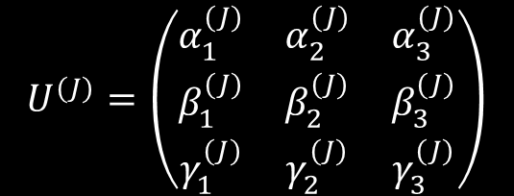





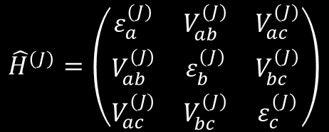



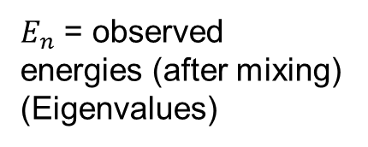




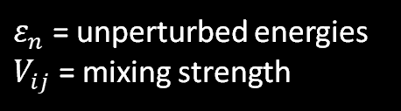



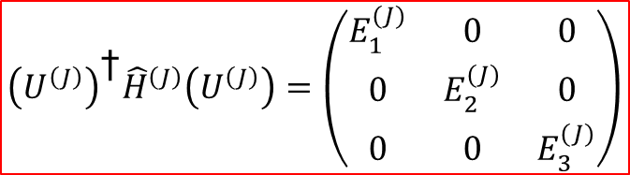


3-state Mixing Calculations: Setup
$$β_{c}$$
$$β_{a}$$
$$β_{b}$$
$${\hat{H}}^{(J)}=\left(\begin{matrix}ε_{a}^{(J)} & V_{ab}^{(J)} & V_{ac}^{(J)} \\ V_{ab}^{(J)} & ε_{b}^{(J)} & V_{bc}^{(J)} \\ V_{ac}^{(J)} & V_{bc}^{(J)} & ε_{c}^{(J)}\end{matrix}\right)$$
$ε_{n}$ = unperturbed energies
$V_{ij}$ = mixing strength
$${\left(U^{\left(J\right)}\right)}^{\text{†}}{\hat{H}}^{\left(J\right)}\left(U^{\left(J\right)}\right)=\left(\begin{matrix}E_{1}^{(J)} & 0 & 0 \\ 0 & E_{2}^{(J)} & 0 \\ 0 & 0 & E_{3}^{(J)}\end{matrix}\right)$$
C
A
B
$$E_{3}^{(J=2)}$$
$$2_{b}^{+}$$
$$E_{2}^{(J=2)}$$
$E_{n}$ = observed energies (after mixing) (Eigenvalues)
$$2_{c}^{+}$$
$$0_{b}^{+}$$
$$E_{3}^{(J=0)}$$
$$2_{a}^{+}$$
$$E_{1}^{(J=2)}$$
$$E_{2}^{(J=0)}$$
$$U^{(J)}=\left(\begin{matrix}α_{1}^{(J)} & α_{2}^{(J)} & α_{3}^{(J)} \\ β_{1}^{(J)} & β_{2}^{(J)} & β_{3}^{(J)} \\ γ_{1}^{(J)} & γ_{2}^{(J)} & γ_{3}^{(J)}\end{matrix}\right)$$
$$0_{a}^{+}$$
mixing amplitudes
(Eigenvectors)
$$\left.\left|{\text{Ψ}}_{1}^{(J)}\right.\right\rangle$$
$$\left.\left|{\text{Ψ}}_{2}^{(J)}\right.\right\rangle$$
$$\left.\left|{\text{Ψ}}_{3}^{(J)}\right.\right\rangle$$
$$0_{c}^{+}$$
$$E_{1}^{(J=0)}$$

Slide 16
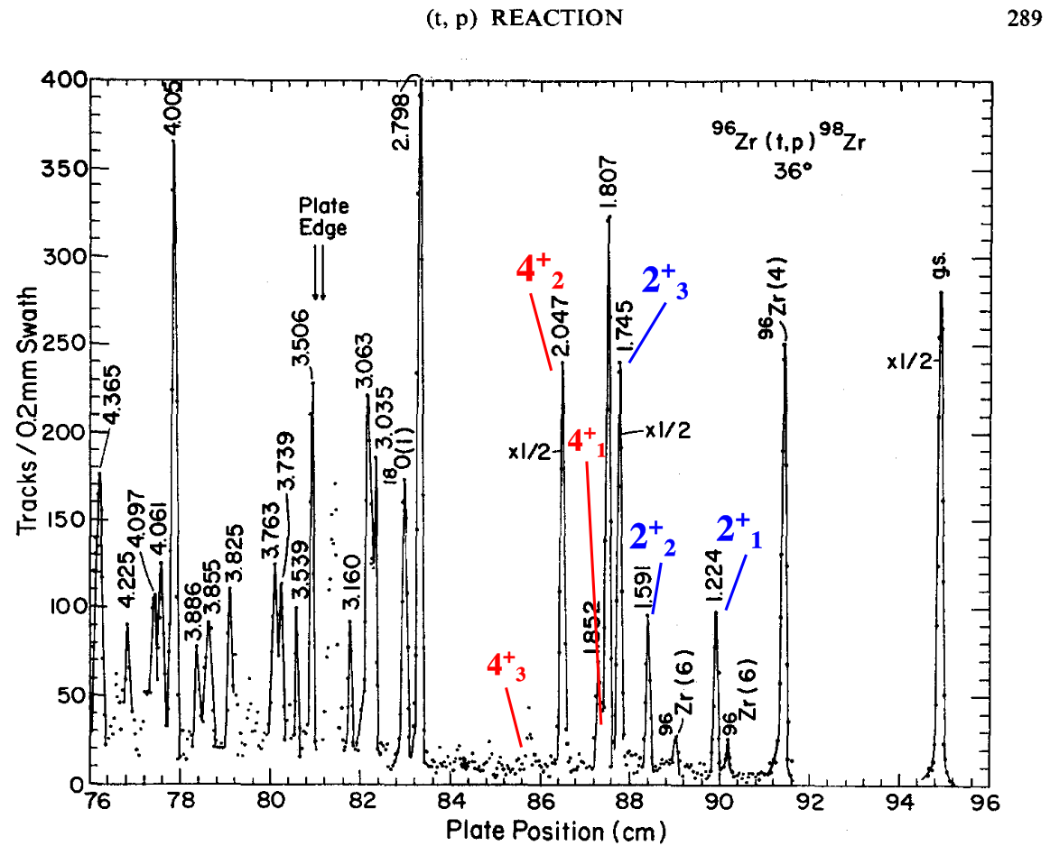




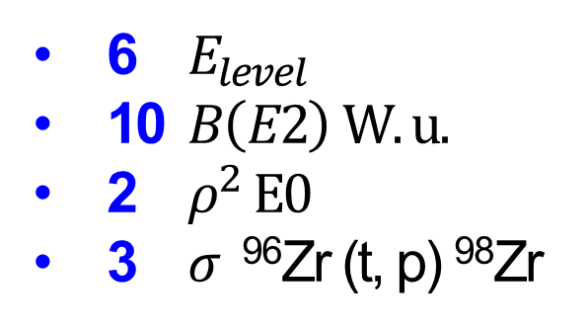


3-Level Mixing Calculations
E. R. Flynn, et. al, Nucl. Phys. A 218, 285-306 (1974)
6 $E_{level}$
10 $B\left(E2\right) W.u.$
2 $ρ^{2} E0$
3 $σ$ ⁹⁶Zr (t, p) ⁹⁸Zr
$$2_{3}^{+}$$
1745
$$2_{2}^{+}$$
1591
$$0_{3}^{+}$$
1436
$$2_{1}^{+}$$
1223
$$0_{2}^{+}$$
854
$$0_{1}^{+}$$
0
Notes:
6 Energies, 6 V_ij, 3 M20s
6 Energies, 10 B(E2)s, 2 rho2(E0)s, 3 (t,p) x-secs

Slide 17
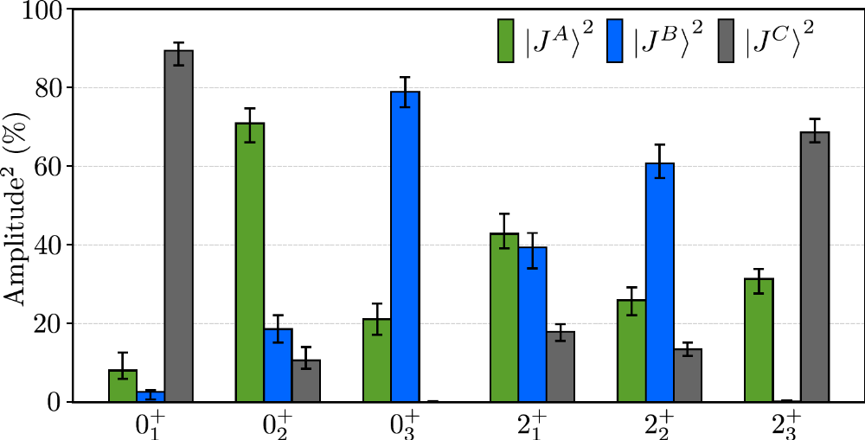


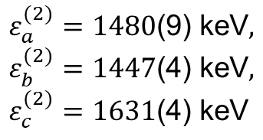

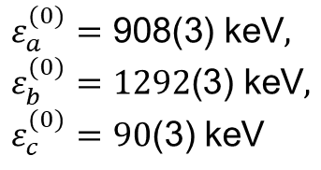
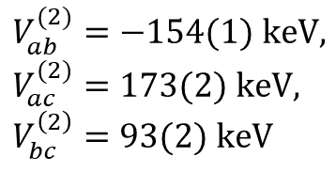

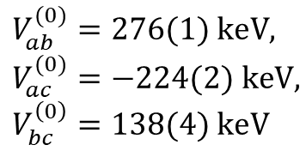


Mixing
$$ε_{a}^{(0)}=\text{908}\text{(}\text{3}\text{)}\text{ keV}, ε_{b}^{(0)}=\text{1292}\text{(3) keV}, ε_{c}^{(0)}=\text{90}\text{(3) keV}$$
$$ε_{a}^{(2)}=\text{1480}\text{(}\text{9}\text{)}\text{ keV}, ε_{b}^{(2)}=\text{1447}\text{(}\text{4}\text{) keV}, ε_{c}^{(2)}=\text{1631}\text{(}\text{4}\text{) keV}$$
$$V_{ab}^{(0)}=\text{276(}1) keV, V_{ac}^{(0)}=−224(2) keV, V_{bc}^{\left(0\right)}=138(4) keV$$
$$V_{ab}^{(2)}=\text{−154(1)} keV, V_{ac}^{(2)}=173(2) keV, V_{bc}^{\left(2\right)}=93(2) keV$$
Experiment
$$β_{c}=\text{0.}\text{001}\text{(}\text{3}\text{)}, β_{a}=\text{0.113(5)}, β_{b}=0.308\left(5\right)$$
$$2_{3}^{+}$$
1745
<13
$$2_{2}^{+}$$
1591
$$2_{3}^{+}$$
1745
0.53
$$2_{2}^{+}$$
1591
6(3)
33(15)
$$0_{3}^{+}$$
41(18)
1436
31.9
$$0_{3}^{+}$$
36.5
1436
$$2_{1}^{+}$$
1223
60(8)
$$2_{1}^{+}$$
1223
59.8
1.3(6)
1.5
12(3)
1.5(7)
89(13)
13.4
1.9
88.8
$$0_{2}^{+}$$
854
$$0_{2}^{+}$$
854
1.5(2)
1.7
0.2(1)
0.3(1)
0.18
0.33
8.6(5)
8.3
$$0_{1}^{+}$$
$$0_{1}^{+}$$
0
0

Slide 18
Mixing
GS remains nearly pure with spherical configuration – consistent with phase transition behaviour. Excited states strongly mixed.
Experiment
$$β_{c}=\text{0.}\text{001}\text{(}\text{3}\text{)}, β_{a}=\text{0.113(5)}, β_{b}=0.308\left(5\right)$$
$$2_{3}^{+}$$
1745
<13
$$2_{2}^{+}$$
1591
$$2_{3}^{+}$$
1745
0.53
$$2_{2}^{+}$$
1591
6(3)
33(15)
$$0_{3}^{+}$$
41(18)
1436
31.9
$$0_{3}^{+}$$
36.5
1436
$$2_{1}^{+}$$
1223
60(8)
$$2_{1}^{+}$$
1223
59.8
1.3(6)
1.5
12(3)
1.5(7)
89(13)
13.4
1.9
88.8
$$0_{2}^{+}$$
854
$$0_{2}^{+}$$
854
1.5(2)
1.7
0.2(1)
0.3(1)
0.18
0.33
8.6(5)
8.3
$$0_{1}^{+}$$
$$0_{1}^{+}$$
0
0

Slide 19
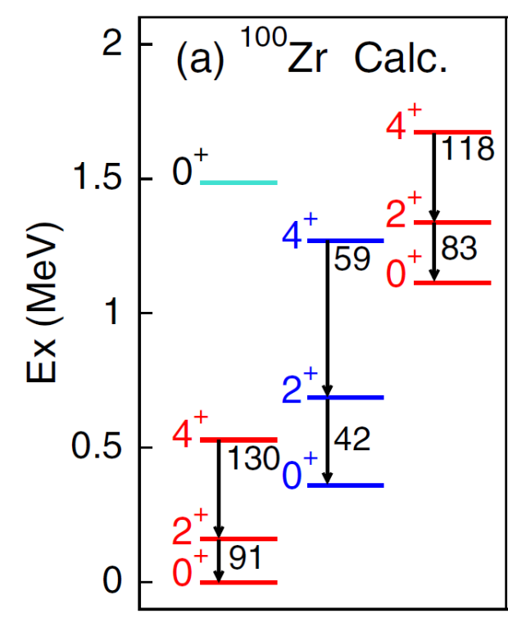

Strong similarity of ⁹⁸Sr, ¹⁰⁰Zr structure
Less collectivity in 0₂⁺ band than predicted – likely the “spherical” configuration
¹⁰⁰Zr studied with β-decay at TRIUMF-ISAC; level scheme constructed (D. Kalaydjieva, M. Zielinska, Saclay), 0₃⁺, 2₂⁺ lifetimes measured (K. Stoychev, H. Bidaman, Guelph)
B(E2) W.u.
10³ρ²(E0)
MCSM
Prolate
Q_{s}(2₁⁺) = ‒0.52(24) eb
Spherical
“Quasi-Spherical”
Q_{s}(2₂⁺) = +0.02(12) eb
Prolate
Prolate
E. Clement et al., PRL 116, 022701 (2016), PRC 94, 054326 (2016).
Oblate

Slide 20
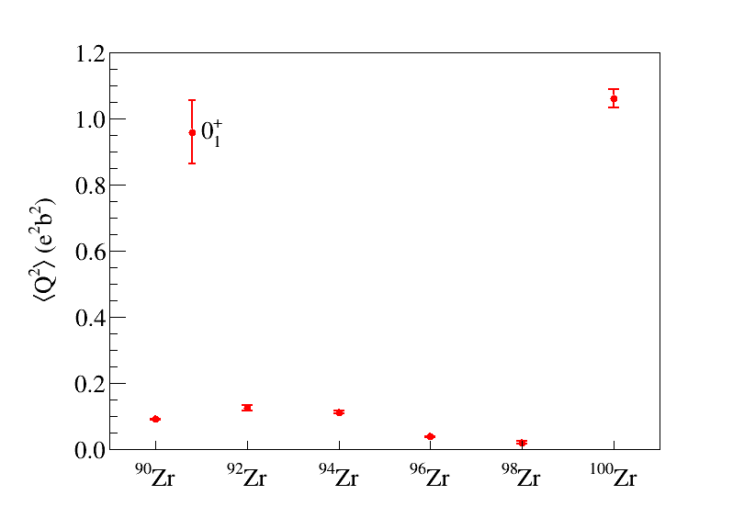
Examining the <Q²> invariant for Zr
Large increase from ⁹⁸Zr to ¹⁰⁰Zr reflects ground-state transition from spherical to deformed

Slide 21
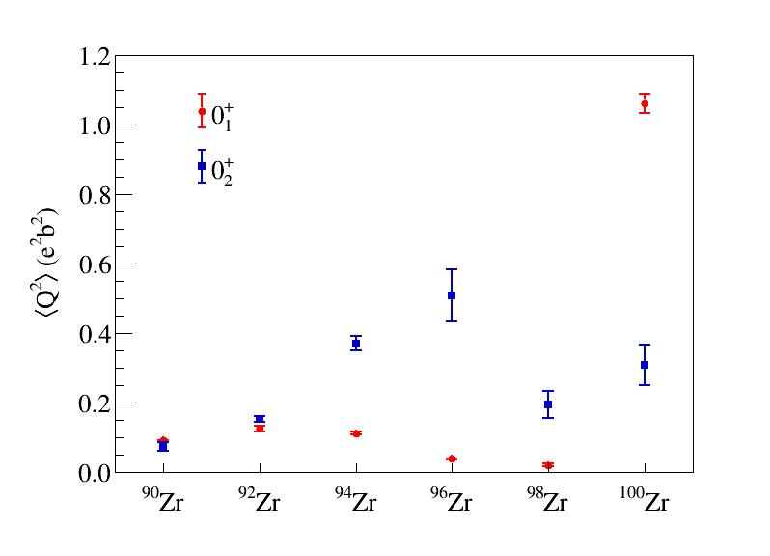
Examining the <Q²> invariant for Zr

Slide 22
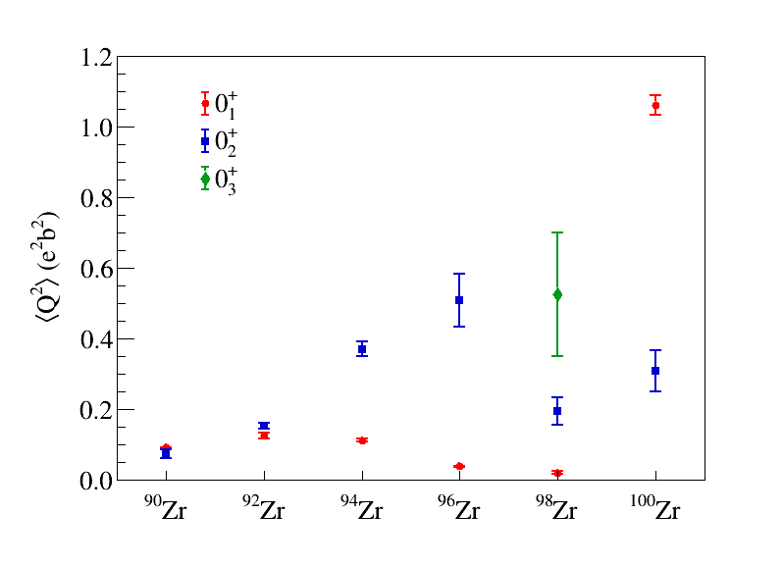
Examining the <Q²> invariant for Zr

Slide 23
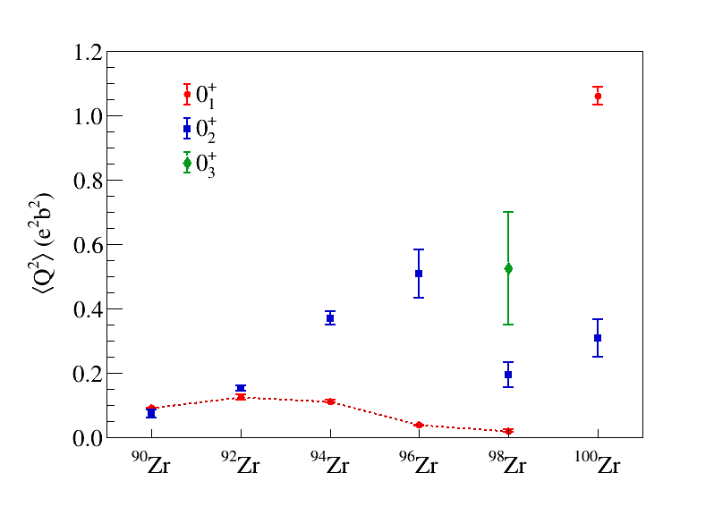
Examining the <Q²> invariant for Zr
well-deformed prolate
spherical

Slide 24
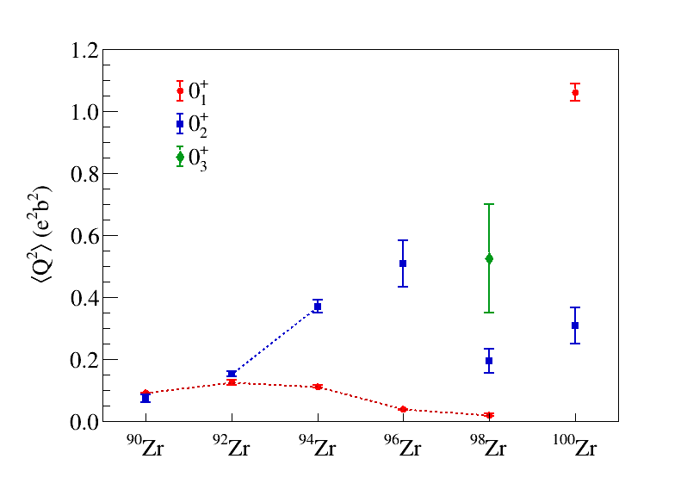
Examining the <Q²> invariant for Zr
well-deformed prolate
Triaxial/ oblate
spherical

Slide 25
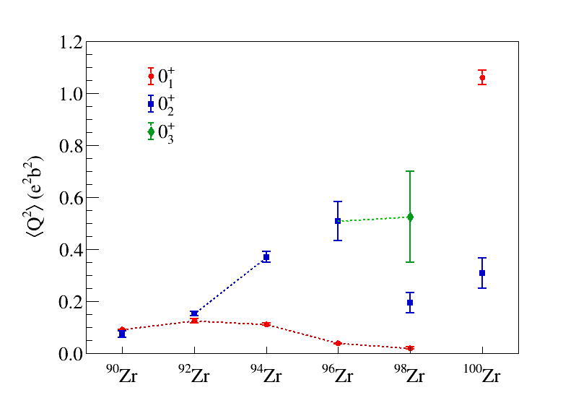
Examining the <Q²> invariant for Zr
well-deformed prolate
A prolate or triaxial structure?
Triaxial/ oblate
spherical
Weakly deformed structures

Slide 26
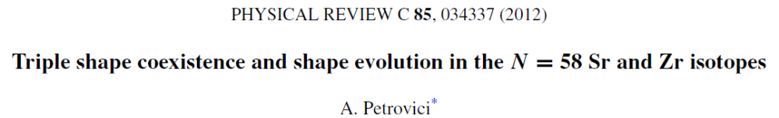
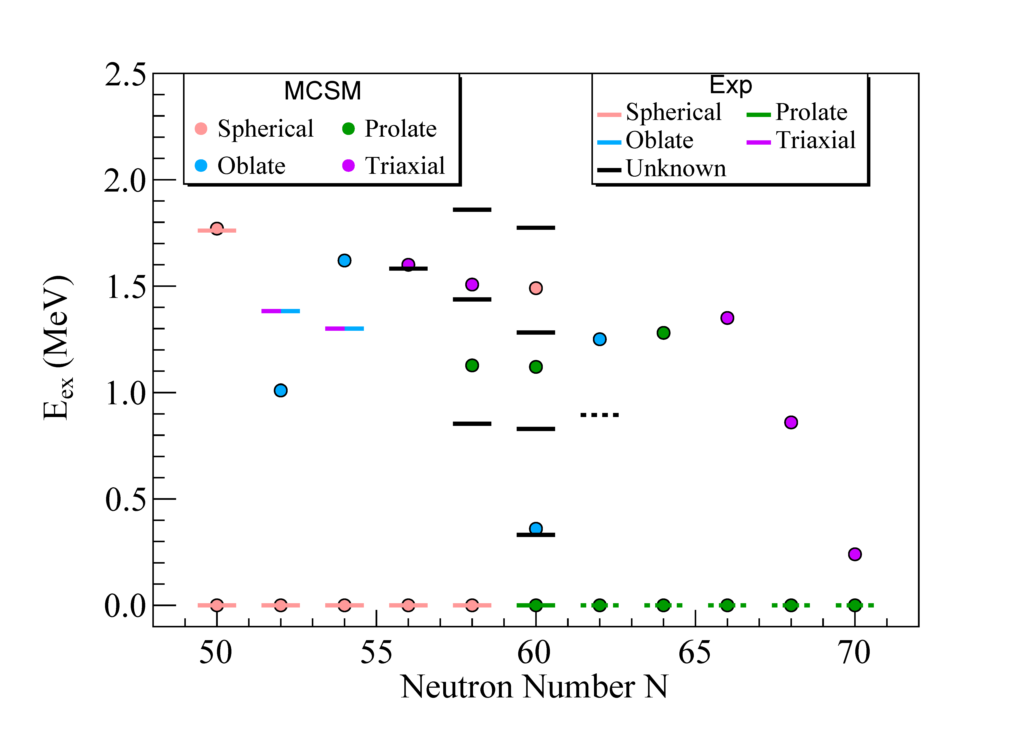
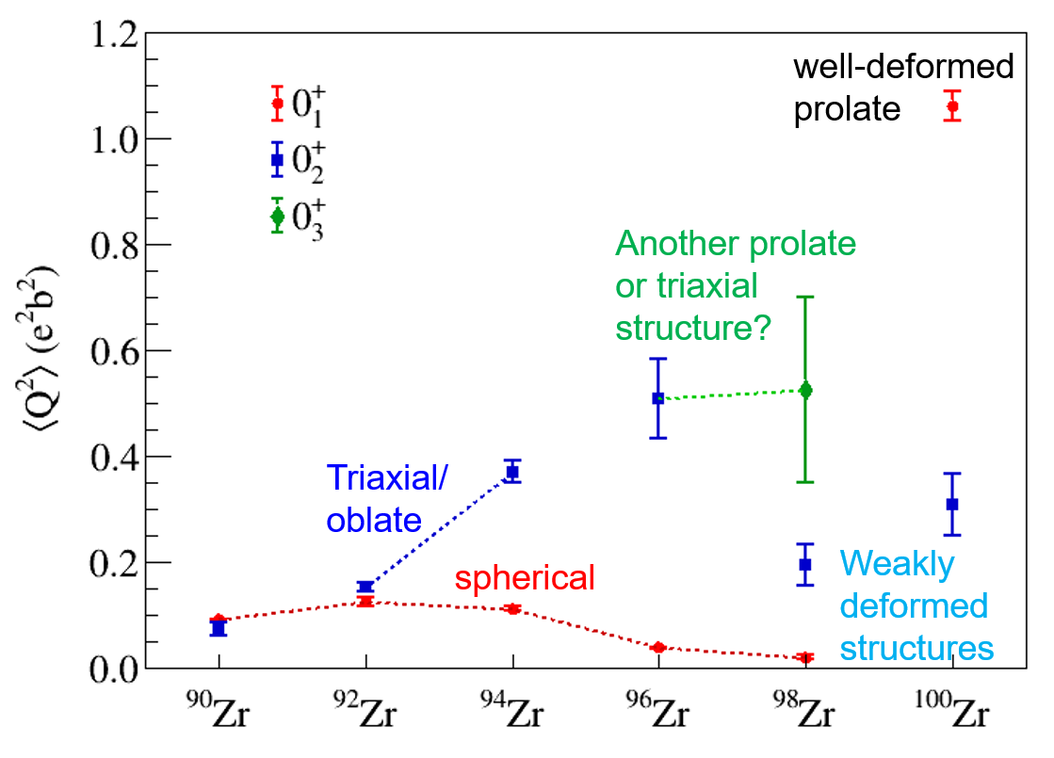
Evidence for triple-shape coexistence in ⁹⁸Zr
Results for ⁹⁸Zr agree “in spirit” with MCSM, BMF approaches of, e.g., SCCM and excited VAMPIR, of presence of multiple shapes
MCSM
⁹⁸Sr
Conclusion: we have multiple shapes throughout the region

Slide 27
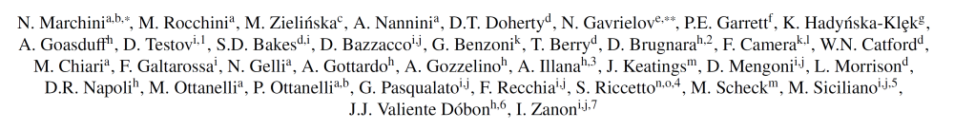
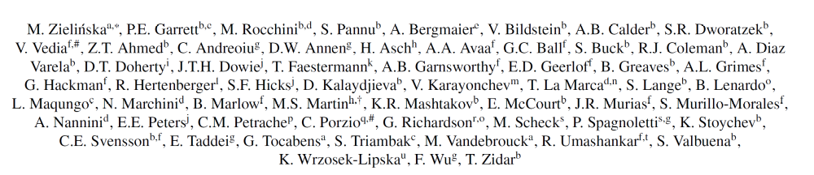
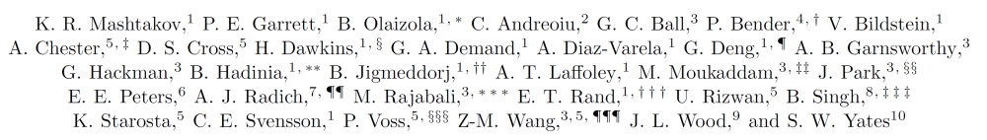
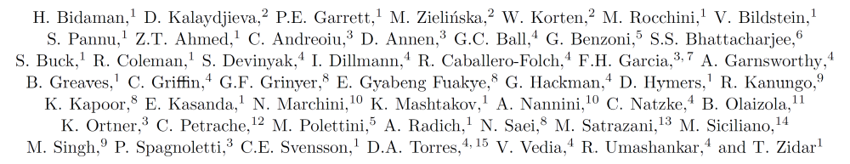
Collaborators on Zr projects
92Zr
94Zr:
96Zr:
98Zr
100Zr:

Slide 28
l

Slide 29
Quantum Phase Transitions
QPT defined when a quantum system experiences a sudden change in its structure (reflected in an order parameter) when a parameter that affects the Hamiltonian (control parameter) slightly changes around its critical value. The transitions are assumed to occur at zero temperature.
1st Order
  Classically – involves discontinuities in a derivative of a quantity such as free energy – ex. phase transitions in water discontinuity in density
2nd Order
  Classically – first derivatives remain continuous, but discontinuity in the second order derivative – ex. heat capacity
Derivatives usually taken with respect to T or P (control parameter)
Ground state QPT – nucleon number acts as the control parameter – discrete instead of continuous
QPTs are smoothed compared to classical systems, and display an intimate connection between dynamics and particle number
A QPT implies an abrupt change in the properties of the ground state that results in the rapid change of several observables, e.g., S_{2n}, E(4⁺₁)/E(2⁺₁), B(E2:2⁺₁→ 0⁺₁) values, etc.

Slide 30
⁹²Zr
⁹⁴Zr
⁹⁶Zr
⁹⁸Zr
¹⁰⁰Zr
¹⁰²Zr
S. Leoni et al., PPNP 139, 104119 (2024)

Slide 32
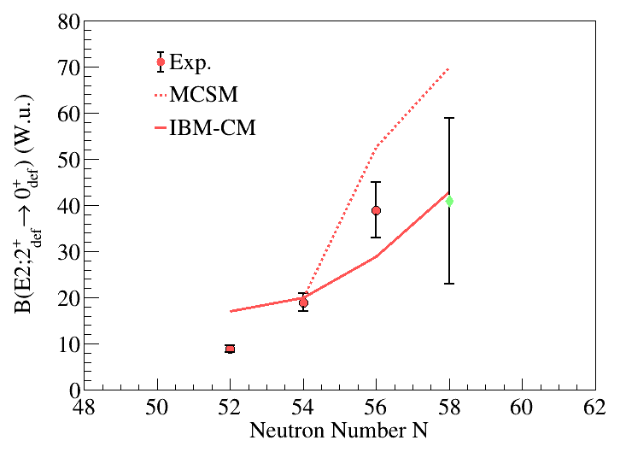
Calculations compared with B(E2;2⁺→0⁺) for higher 0⁺ bands
0₃⁺
0₂⁺

Slide 33
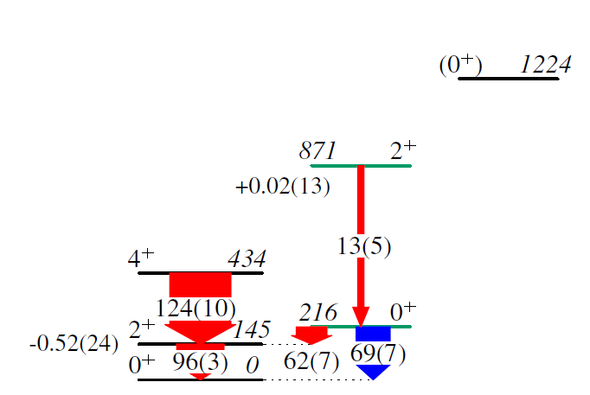
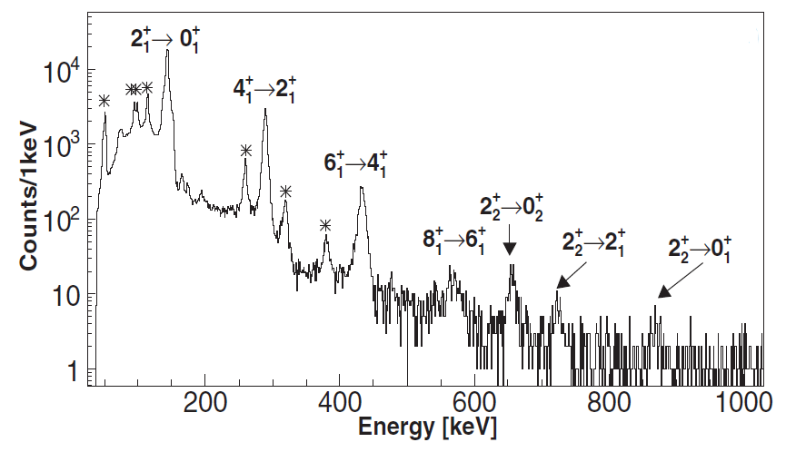
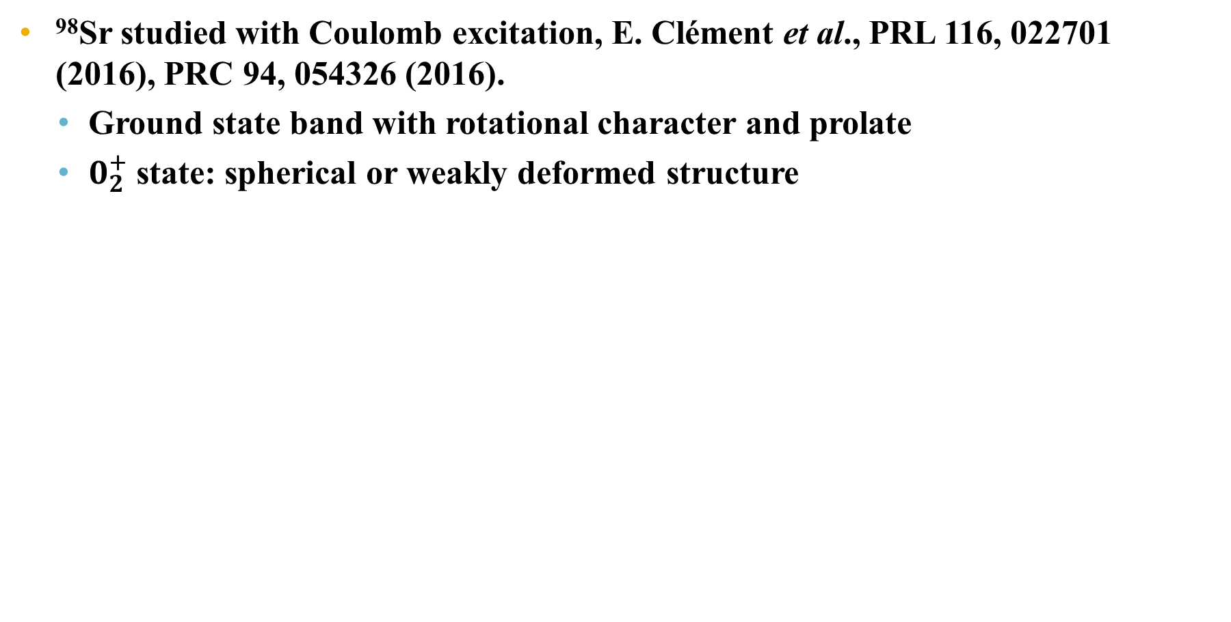

Structure of N = 60 ⁹⁸Sr
⁹⁸Sr studied with Coulomb excitation, E. Clément et al., PRL 116, 022701 (2016), PRC 94, 054326 (2016).
  Ground state band with rotational character and prolate
  $0_{2}^{+}$state: spherical or weakly deformed structure
⁹⁸Sr
⁹⁸Sr + ²⁰⁸Pb
Q_{s} (eb)
B(E2) (W.u.)
-${1.87}_{−25}^{+14}$
10³ ×ρ²(E0)
Notes:
Rotational character from tau and coulex, prolate deformation beta 0.5
Second 0+ state, spherical or weakly deformed from spectroscopic quadrupole moment and B(E2)

Slide 34
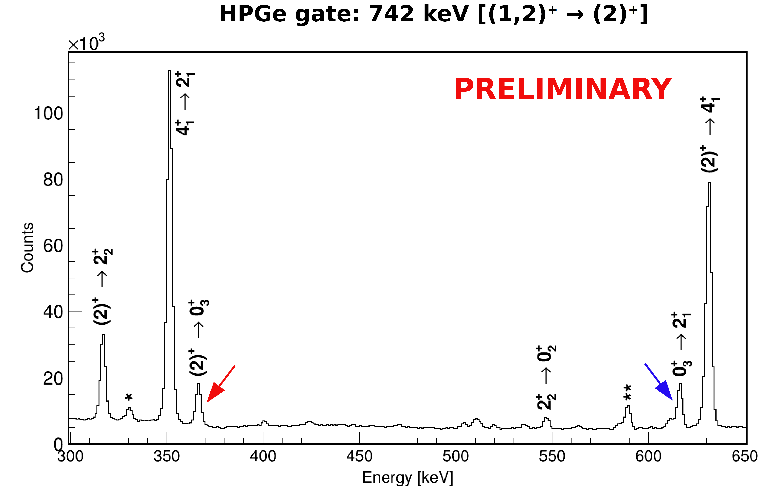
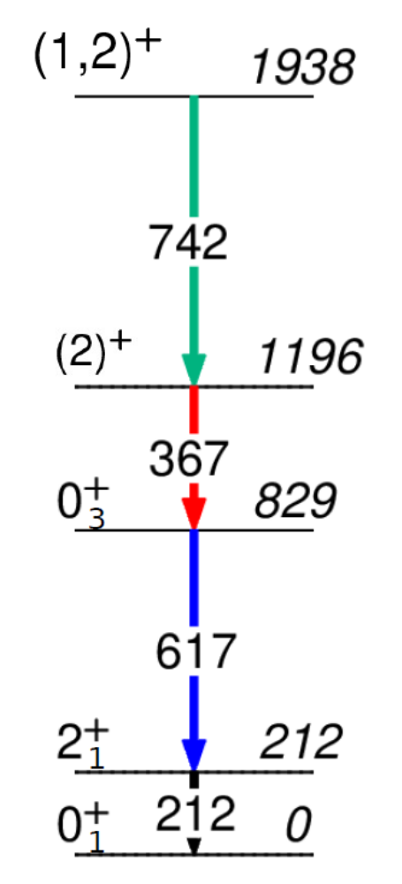
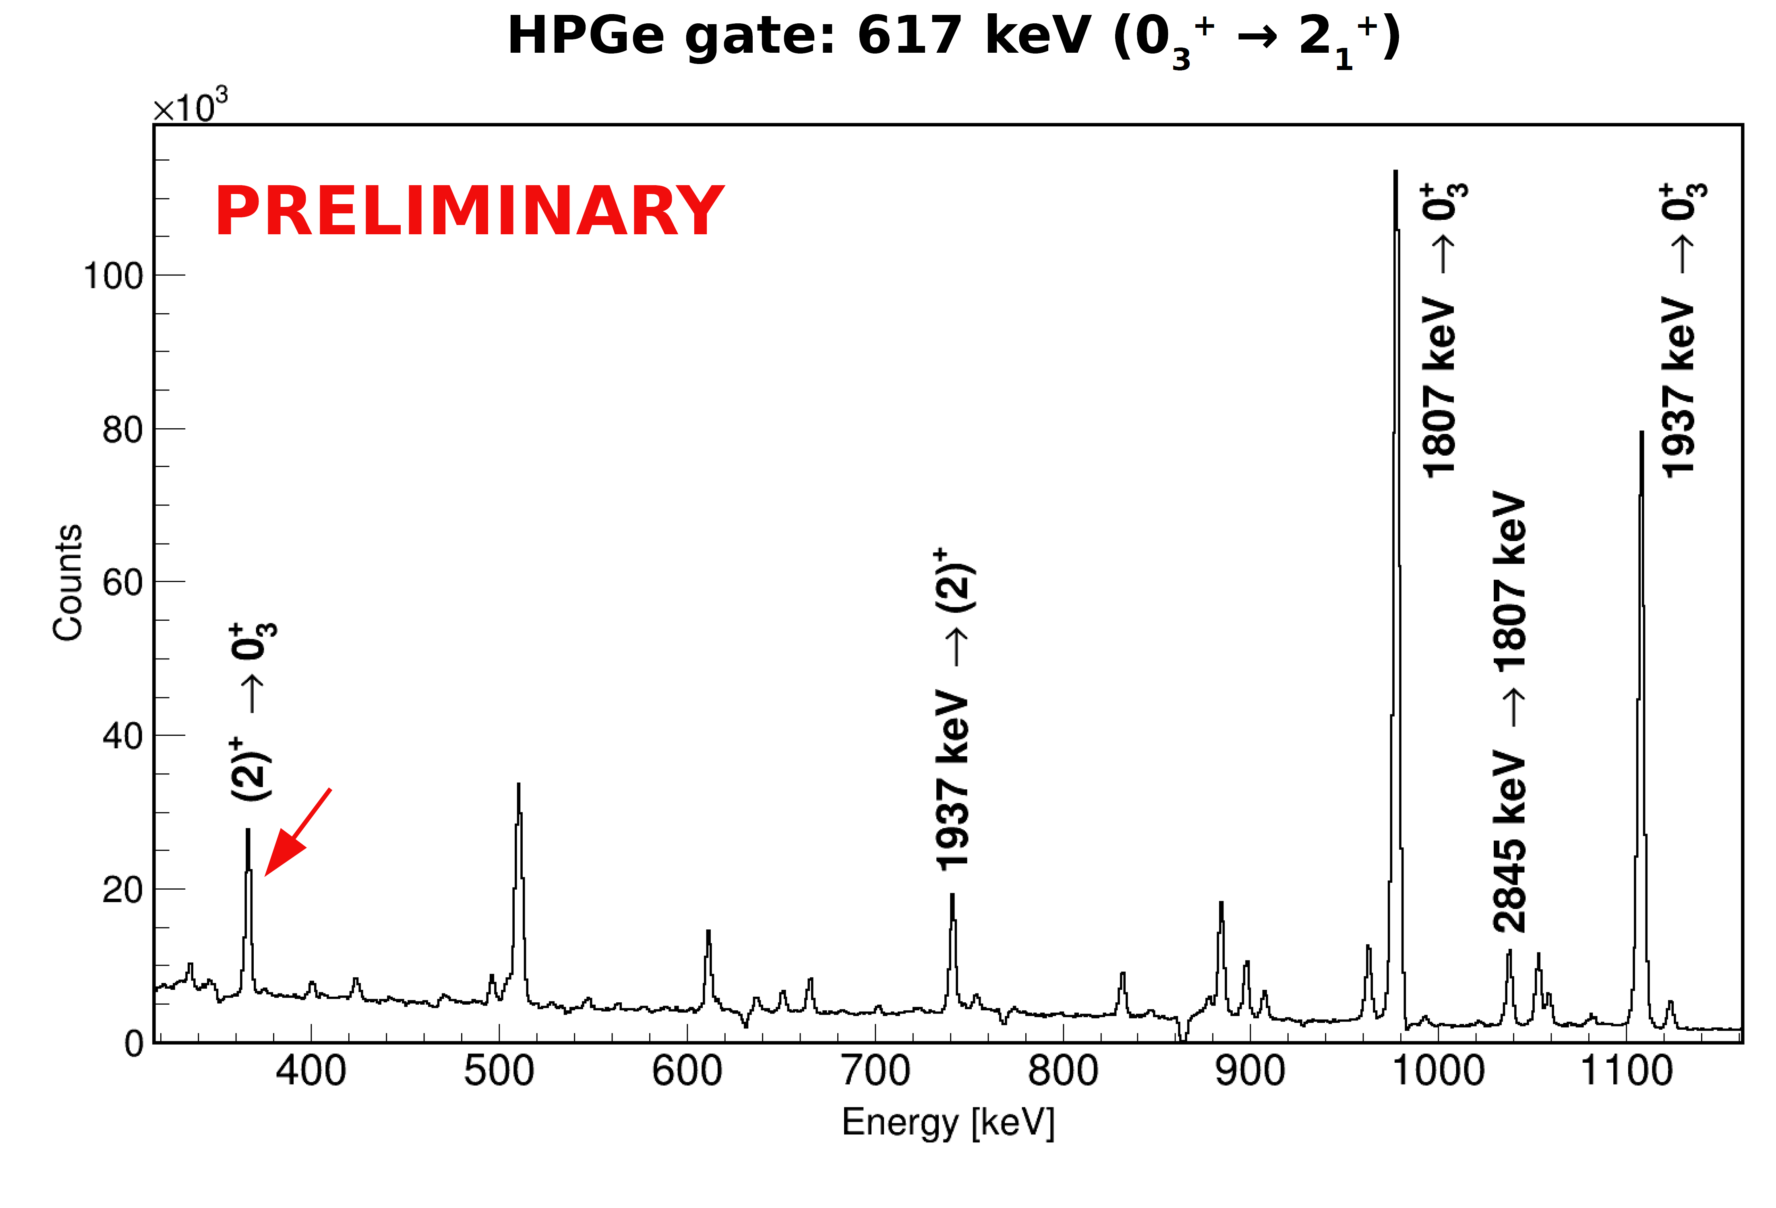
Results from β-decay of ¹⁰⁰Y with the GRIFFIN spectrometer
Key transition: 367-keV 2₃⁺ →0₃⁺ observed in gating from above and below
367-keV transition is ~1.2% branch
Result suggests 1196 keV level is 2⁺ band member
  Spin now firmly established as 2⁺
Level scheme analysis: D. Kalaydjieva, M. Zielinska (CEA Saclay)

Slide 35
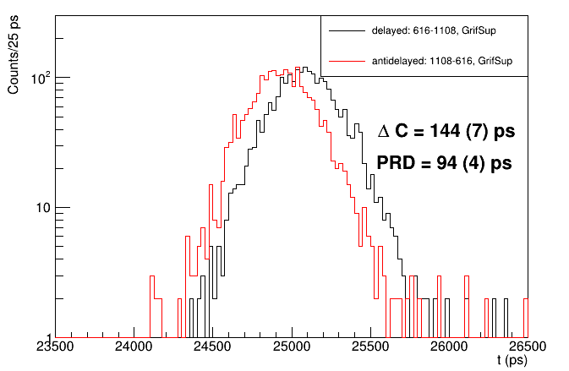
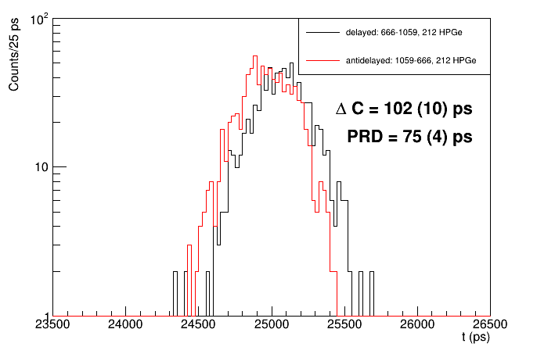
Results in ¹⁰⁰Zr: lifetime of 0₃⁺ and 2₂⁺ levels
B(E2;0₂⁺ → 2₁⁺) = 78(4) W.u., B(E2;2₂⁺ → 0₂⁺) = 8(3) W.u.
  0₂⁺ band appears to be weakly collective, but 0₂⁺ state has highly enhanced transition rate to 2₁⁺
1938
(2⁺)
1938
(2⁺)
LaBr₃ gate
1060-keV
LaBr₃ gate
1108-keV
878
2₂⁺
829
0₃⁺
LaBr₃ gate
666-keV
LaBr₃ gate
616-keV
212
2₁⁺
212
2₁⁺
HPGe gate
212-keV
τ = 23(6) ps
τ = 16(3) ps

Slide 36
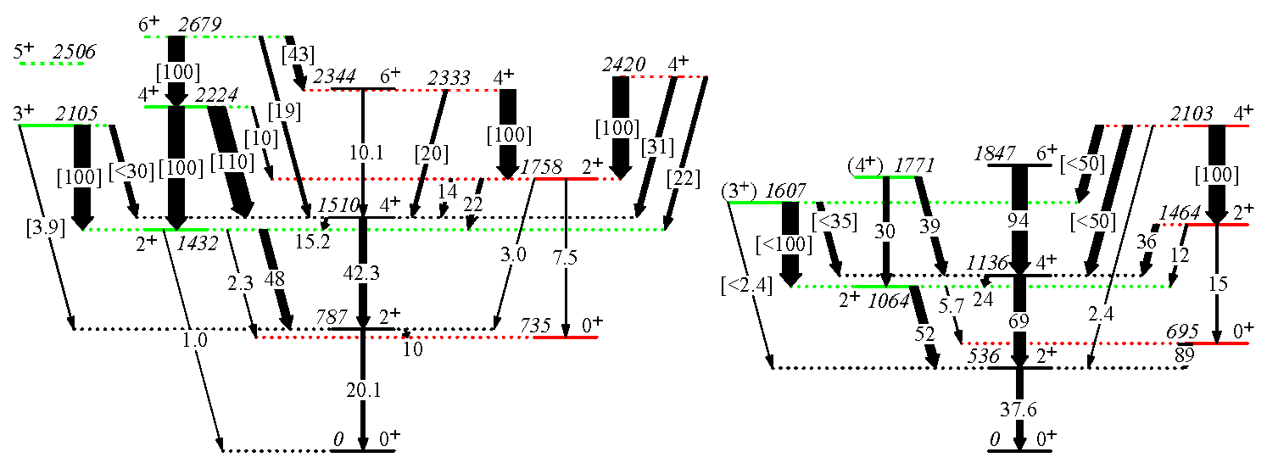
Evidence for triaxial K=2 bands
Triaxial gs implies there should be K=2 bands (not γ vibrations) – not well established in ^{98,100}Mo
B(E2) W.u.
[ rel B(E2) ]
⁹⁸Mo
¹⁰⁰Mo

Slide 38

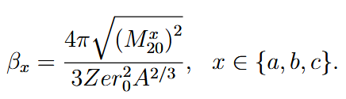
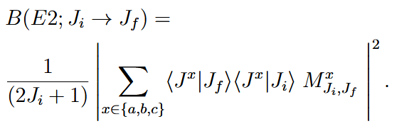
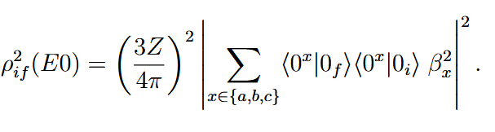
3-Level Mixing Calculations
$$β_{c}$$
$$β_{a}$$
$$β_{b}$$
C
A
B
$$2_{3}^{+}$$
1745
$$2_{2}^{+}$$
1591
$$0_{3}^{+}$$
1436
$$2_{1}^{+}$$
1223
$$0_{2}^{+}$$
854
$$0_{1}^{+}$$
0

Slide 39


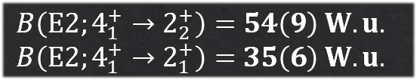
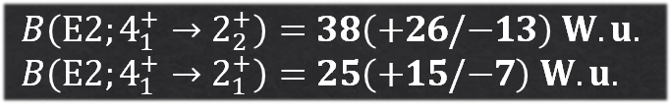
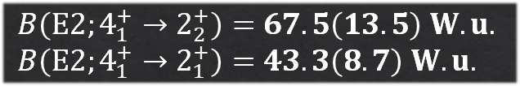



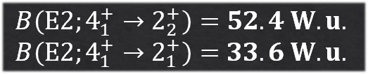


Experiment
Mixing
P. Singh et. al, PRL 121, 192501 (2018)
$$B\left(E2;4_{1}^{+}→2_{2}^{+}\right)=67.5\left(13.5\right) W.u.$$
$$B\left(E2;4_{1}^{+}→2_{1}^{+}\right)=43.3\left(8.7\right) W.u.$$
V. Karayonchev et. al, PRC 102, 064314 (2020)
$$B\left(E2;4_{1}^{+}→2_{2}^{+}\right)=38\left(+26/−13\right) W.u.$$
$$B\left(E2;4_{1}^{+}→2_{1}^{+}\right)=25\left(+15/−7\right) W.u.$$
G. Pasqualato et. al, EPJ A 59, 276 (2023)
$$B\left(E2;4_{1}^{+}→2_{2}^{+}\right)=54\left(9\right) W.u.$$
$$B\left(E2;4_{1}^{+}→2_{1}^{+}\right)=35\left(6\right) W.u.$$
$$B\left(E2;4_{1}^{+}→2_{2}^{+}\right)=52.4 W.u.$$
$$B\left(E2;4_{1}^{+}→2_{1}^{+}\right)=33.6 W.u.$$
$$3_{1}^{−}$$
$$4_{1}^{+}$$
1843
$$4_{1}^{+}$$
1843
1806
$$2_{3}^{+}$$
1745
???
$$2_{2}^{+}$$
???
1591
1745
33.6
$$2_{2}^{+}$$
52.4
1591
$$2_{3}^{+}$$
$$0_{3}^{+}$$
1436
$$0_{3}^{+}$$
1436
$$2_{1}^{+}$$
1223
$$2_{1}^{+}$$
1223
$$0_{2}^{+}$$
854
$$0_{2}^{+}$$
854
$$0_{1}^{+}$$
$$0_{1}^{+}$$
0
0

Slide 40




Experiment
Mixing
G. Pasqualato et. al, EPJ A 59, 276 (2023)
$$B\left(E2;6_{1}^{+}→4_{1}^{+}\right)=95\left(10\right) W.u.$$
$$B\left(E2;6_{1}^{+}→4_{1}^{+}\right)=85\left(15\right) W.u.$$
P. Singh et. al, PRL 121, 192501 (2018)
$$B\left(E2;6_{1}^{+}→4_{1}^{+}\right)=103\left(36\right) W.u.$$
$$B\left(E2;6_{1}^{+}→4_{1}^{+}\right)=94.9 W.u.$$
$$6_{1}^{+}$$
2491
$$6_{1}^{+}$$
2491
???
95
$$3_{1}^{−}$$
$$4_{1}^{+}$$
1843
$$4_{1}^{+}$$
1843
1806
$$2_{3}^{+}$$
1745
35(6)
$$2_{2}^{+}$$
54(9)
1591
1745
33.6
$$2_{2}^{+}$$
52.4
1591
$$2_{3}^{+}$$
$$0_{3}^{+}$$
1436
$$0_{3}^{+}$$
1436
$$2_{1}^{+}$$
1223
$$2_{1}^{+}$$
1223
$$0_{2}^{+}$$
854
$$0_{2}^{+}$$
854
$$0_{1}^{+}$$
$$0_{1}^{+}$$
0
0

Slide 41



Structure of ⁹⁶Sr and ⁹⁸Sr
Strong evidence for $0_{1}^{+}$(⁹⁶Sr) ↔ $0_{2}^{+}\text{(}\text{98}\text{Sr)}$, but we do not know the nature of the excited 0⁺ states in ⁹⁶Sr
Q_{s} (eb)
B(E2) (W.u.)
⁹⁶Sr
⁹⁸Sr
-${1.87}_{−25}^{+14}$
10³ ×ρ²(E0)
Notes:
Strong evidence for similarity 0_1 in 96Sr with 0_2 98Sr, not the opposite (0_2 in 96Sr with 0_1 in 98Sr).
Need to measure B(E2) of 2_2+→0_2+ in 96Sr

Slide 42

Multiparticle-multihole states and shape coexistence
Deformation is driven by the quadrupole-quadrupole interaction between protons and neutrons – the more valence particles of both types, the greater the deformation (up to a point)
There can be a substantial gain in energy due to correlations between the particles such that the energy cost for promoting particle across shells can be offset
The most common mechanism to generate states with different shapes involves the creation of multiparticle-multihole states
Heyde and Wood, RMP 83, 1467 (2011)

Slide 43



Evolution of <Q²>
Prolate
Shape inferred from Coulex
Prolate
Prolate
Triaxial
Triaxial
Prolate
Prolate
Triaxial
Q_{s}(2⁺)
Prolate
Prolate
Prolate
Inferred shapes
“Quasi-spherical”
Oblate
“Quasi-spherical”
“Quasi-spherical”

Slide 44

Evolution of <Q²>
Prolate
Shape inferred from Coulex
Prolate
Prolate
Triaxial
Triaxial
Prolate
Prolate
Triaxial
Q_{s}(2⁺)
Prolate
Prolate
Prolate
Inferred shapes
“Quasi-spherical”
“Quasi-spherical”
Triaxial
“Quasi-spherical”

Slide 45
Comparison of ⁹⁴Zr – ⁹⁶Zr
Significant difference in energy spacing of deformed structures
  ⁹⁴Zr 371 keV, ⁹⁶Zr 644 keV
and in-band B(E2;2→0) values (↑ in ⁹⁶Zr)
Differences indicative of a change of configurations of 0₂⁺ states between ⁹⁴Zr and ⁹⁶Zr
B(E2) W.u.
10³ρ²(E0)
M. Zielińska et al., PLB 877, 140481 (2026)

Slide 46

Evidence for configuration change in 0₂⁺ band
Series of Mo(d,⁶Li)Zr reactions reveal stronger population of 0₂⁺ state in ⁹⁶Zr vs. 0₁⁺ state, unlike all other Zr isotopes where 0₁⁺ is factor ~ 5 larger
Likely there are three distinct shapes occurring in ⁹⁴Zr – ⁹⁶Zr
Saha et al., PLB 82, 208 (1979)

Slide 47

Theoretical calculations for the Zr isotopes vs. experiment
Two recent approaches – Monte Carlo Shell Model (MCSM), and Interacting Boson Model with Configuration Mixing (IBM-CM)
IBM-CM
MCSM
N. Gavrielov, A. Leviatan, and F. Iachello, PRC 105, 014305 (2022).
T. Togashi et al., PRL 117, 172502 (2016)

Slide 48



Lifetime measurements in ¹⁰⁰Zr
GRIFFIN HPGe selects pathway, TAC START and STOP selected in LaBr₃ coincidence events.
⁶⁰Co 1332+1173 keV gated
Comparison of HPGe and LaBr₃ specta with 1060-keV HPGe gate, 212 (top) or 666 (bottom) keV LaBr₃ gate
HPGe gate
1060-keV
878
2₂⁺
TAC spectra for 212-keV level after gating
LaBr₃ gate
666-keV
212
2₁⁺
LaBr₃ gate
212-keV
Procedure of comparing HPGe and LaBr₃ spectra adopted for all possible gating transitions
Final result: 857(12) ps, NNDC 828(22) ps

